Slide 1

Board Training

Slide 2

A few simple guidelines
As we begin the training session, please follow a few basic guidelines to ensure productive results:
Be present by silencing all cell phones and put them to the side, face down.
Ask questions as they arise! (Please no side conversations)
We will have a “Parking Lot” for ideas that need further discussion.
Think in terms of your role as a Board Member; responsible for the well-being and future of this organization.

Slide 3
Topics
Introductions & Board Training
  Why Are We Here
  Mission of NEWH
  Responsibilities of the Board
  Board Member Roles
Review Member Survey
SGOT Analysis
  Strengths
  Gaps
  Opportunities
  Threats
Breakouts – Programming/Fundraising, Membership, Marketing, Scholarship
Breakout Report back
Chapter Budget Review
Review NEWH Website
Wrap Up & Adjourn

Slide 4
Why are we here?
Knowledge is POWER!
  NEWH involvement will strengthen your professional skills while helping build a stronger Board for the benefit of your Chapter and local hospitality community.
To share key information about the organization, including history, mission, and goals of NEWH.
To understand each person’s Board Position and how you all work together to make your Chapter a success.
To ensure you have all the tools needed to be successful in your position.
To review what your Members want and how to implement their needs into your strategic plan.
To get to know each other!

Slide 5


“There is only one thing worse than training your volunteers and having them leave – and that's not training them and having them stay.”
-unknown

Slide 6
NEWH Timeline
1984
2000
2011
2024
Founded in Los Angeles
13 US Chapters
17 US Chapters and 8 US/International Regional Groups
Leading Non-Profit International Hospitality Organization
30 Chapters/Regional Groups in the US, Canada, UK, Paris, & Milan
First Scholarship
International Expansion -
Toronto Chapter and UK Chapter
International Expansion - Paris & Milan Chapters
1987
2004
2019
NEWH, Inc. is a 501(c)(3) non-profit organization founded in 1984 in Los Angeles, California by a group of women that shared a vision for females to have professional success in the hospitality industry. They founded the Network of Executive Women in Hospitality to provide networking opportunities with women engaged in careers related to hospitality design; hotels, motels, resorts, restaurants, cruise ships, casinos and other commercial properties. They decided to focus on sharing education and build a network of volunteers that would work towards a common mission to raise scholarship funds for deserving students pursuing careers in hospitality. The mission and organization quickly grew and opened membership and board participation to include men by 1993. NEWH, Inc. today is comprised of over 6,600 members, 30 Chapters and Regions has awarded more than $9.2 million dollars in scholarships funds to over 3,100 students.

Slide 7

NEWH Vision
“The Hospitality Industry Network”

Slide 8
Our Mission
  NEWH is the international community connecting the hospitality industry, providing scholarships, education, leadership development, recognition of excellence, and business development opportunities.

Slide 9




What we do:
Scholarship
Education
Networking
NEWH has awarded over $9.2 million in scholarships that have impacted more than 3,100 students and their families from around the world. Volunteers are the driving force behind these astounding results.
NEWH offers events and programs providing educational opportunities for students and hospitality industry professionals related to their fields including design, procurement and sales. NEWH events bring knowledge from CEUs, hotel tours to visionary panel discussions from leading industry professionals.
As part of its mission, NEWH connects students and professionals wishing to pursue careers in the hospitality industry with companies that have projects, job openings and internship programs.

Slide 10
Nonprofit vs for-profit
What is the difference?
NONPROFIT
FOR PROFIT
Organization provides services of benefit without financial incentive
Organization operates for personal or corporate monetary gain
For-Profit organization is governed by a Board of Directors – Directors are paid for their service
Stockholders own a for-profit business
Nonprofit is qualified by the IRS as a tax-exempt organization through education and scholarship
Voluntary trustees govern the Nonprofit, protecting members’ interest
Nonprofit owned by the public; status is granted by the IRS
NEWH, Inc. as a 501(c)(3) does not lobby

Slide 11






NEWH Partnerships
International
Design
Brand
Green Voice
Corporate Partners
Media
NEWH has built strategic alliances and partnerships to benefit its Members and the driving mission of education, networking and raising scholarship funds for students pursuing careers in hospitality.

Slide 12

Corporate Partners
NEWH Corporate Partners are primarily comprised of manufacturers that manufacture products for the hospitality industry. These relationships bring financial stability to the organization.
Corporate Partners allow NEWH to keep dues at an affordable rate, host in-person International Board of Director meetings and support new membership initiatives.
NEWH has 3 levels of NEWH Corporate Partnership ($18,000-$38,500 USD per year).

Slide 13
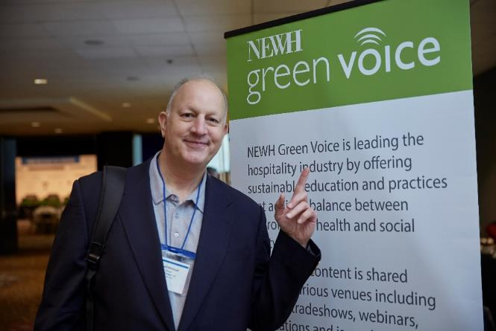
Green Voice
NEWH supports a focused educational initiative related to sustainability and the protection of our environment.
Green Voice Partners financially support the needs related to resourcing credible talent and professional expertise that can deliver comprehensive knowledge about sustainability at international expositions and conferences.
NEWH includes the vision of our students through design competitions tapping into their creative design solutions that benefit the world of hospitality.

Slide 14
Media
NEWH Media Partners bring strength to the extensive international network with their vast reach into the market connecting with executives and professionals that lead the industry with innovative thought, influence, and action.
These partners provide NEWH and its members presence at the international expositions, conferences, and trade fairs allowing NEWH the opportunity to spread their message and share initiatives that benefit the entire industry and those that support it. Many of these partners assist NEWH in promotion of its members and supporters through their globally renowned publications.

Slide 15

Brand
NEWH BrandED Program Partners lead the charge for bringing the highest level of education to our professional members. We provide live educational sessions that host the brand partners as they share pertinent information with a perspective on pipeline and design expectations related to the brand distinctions.
NEWH BrandED Program Sponsors are manufacturing companies that support this educational and networking initiative for NEWH. This program funds multiple scholarships per year presented at international events.

Slide 16

Design
NEWH is committed to acknowledging and promoting its member firms through programs such as Top Interior Designers (TopID), which celebrates its talented and innovative design professionals.
We are proud to promote our members throughout the world as leaders in design excellence with a heart for giving back to the hospitality community.

Slide 17
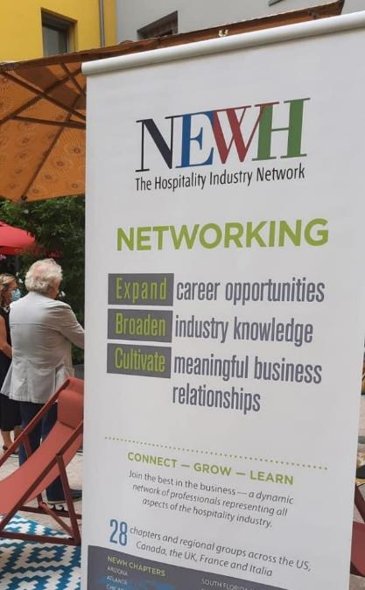
International
The strength of NEWH’s network comes from the expansion of Chapters and Regions to selective hospitality communities.
We align with International Partners that provide financial support and cultural guidance related to building these regions to support their businesses and local hospitality industry.

Slide 18
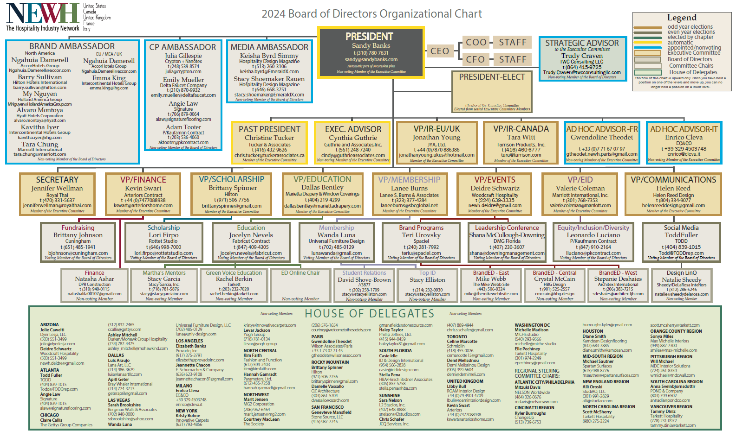

Slide 19
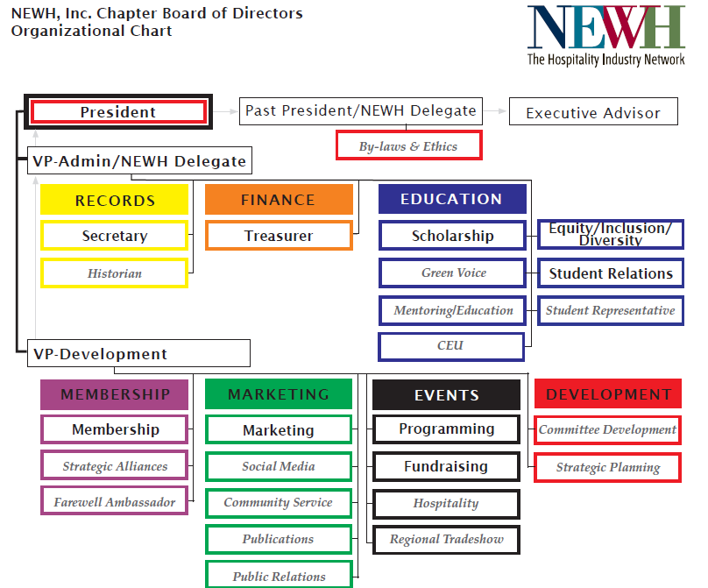

Slide 20
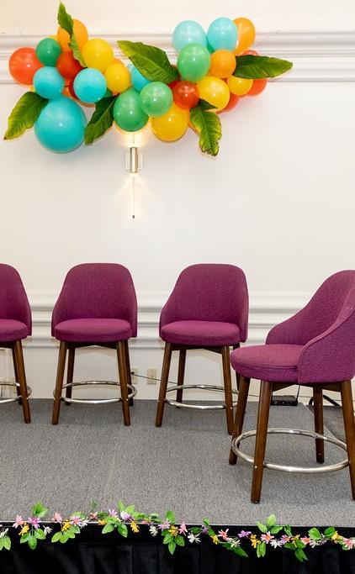
UNDERSTANDING THE CHAPTER BOARD SUCCESSION PLAN
NEWH, Inc. has a succession plan policy in place for Chapters to follow. Succession planning ensures knowledge and stability for the Chapter and follows the NEWH, Inc. Board Model. The VP/Development, VP/Administration, President, Past President, and Executive Advisor positions are part of the succession plan - beginning with the VP/Development position which is elected.
Each position is a one-year term, which means when you accept to run for VP/Development you are making a 5-year commitment to your Chapter. No person shall serve on the Board more than ten (10) years.
The VP/Administration and Past President will also serve as the Chapter’s NEWH Delegate.
*NOTE: In the UK, the delegate position is a floating position for a Board Member who can attend the IBoD meeting in the U.S.

Slide 21
Board Positions
Executive Committee (1 vote each, unless indicated)
VP – Administration/NEWH Delegate*
VP – Development
Secretary
Treasurer
Past President/NEWH Delegate*
Executive Advisor* (no vote)
*Automatic positions are part of succession plan and begin at the VP/Development position, which is elected. After one year in the position, the person will move to the next level. This ensures knowledge and stability for the Chapter and follows the NEWH, Inc. Board Model. All other positions are one-year positions with a 2-year maximum per position.
President* (no vote, unless tie)

Slide 22
Board Positions
Continued
Directors (1 vote each)
Scholarship
Equity, Inclusion, and Diversity
Membership
Programming
Fundraising
Marketing
Student Relations
Chairs (no vote)
Community Service
Hospitality
Social Media
Public Relations
Publications
Green Voice
Student Rep
Other
Quorum = 50% of voting members +1
Email Vote: To be valid, the vote must be unanimous and have 100% participation/reply of all voting Board Members

Slide 23

The Board/Chapter –
NEWH, Inc. Staff Relationship
Two Elements, One Team
Consider it a partnership, alliance, collaboration between Chapter Boards and the NEWH, Inc. staff to achieve the goals of NEWH.

Slide 24
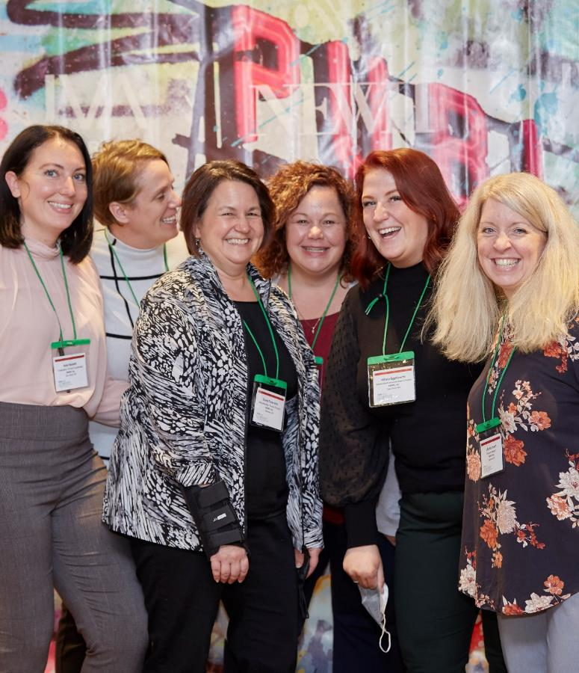
Contact Us!
Feel free to contact the NEWH, Inc. Office if you have ANY questions.
Questions can be directed to:
  President/VPs/Delegates – Shelia Lohmiller or Diane Federwitz
  Treasurer/Finance/Insurance – Susan Huntington or Julie Hartmann
  Secretary – Sarah Von Deck
  Office Administrator – Sarah Von Deck
  Membership – Diane Federwitz, Kathy Coughlin, Nancy Patrick
  Scholarship/Education/EDOnline – Erika Swansen
  Communication/Marketing/Social Media – Hillary Eggebrecht
  Programming/Fundraising – Diane Federwitz; Event RSVPs – Julie Hartmann and Denise Huntington
  Regional Tradeshows/Corporate Partners/Leadership Conference – Jena Seibel and Kate Nesbitt
  Website/Newsletters – Diane Federwitz
  Other questions – just call, we’d be glad to help!

Slide 25
Contact Us!
Email us directly at: General emails:
diane.federwitz@newh.org newh.membership@newh.org
jena.seibel@newh.org newh.education@newh.org
julie.hartmann@newh.org newh.finance@newh.org
kathy.coughlin@newh.org leadership.conference@newh.org
hillary.eggebrecht@newh.org newh.scholarship@newh.org
kate.nesbitt@newh.org newh.tradeshows@newh.org
susan.huntington@newh.org continuing.education@newh.org
shelia.lohmiller@newh.org newh.magazine@newh.org
erika.swansen@newh.org
denise.huntington@newh.org
sarah.vondeck@newh.org
nancy.patrick@newh.org
NEWH, Inc.
P.O. Box 322
Shawano, WI 54166-0322
800.593.NEWH (6394)
Fax 800-693-NEWH (6394)
info@newh.org

Slide 26
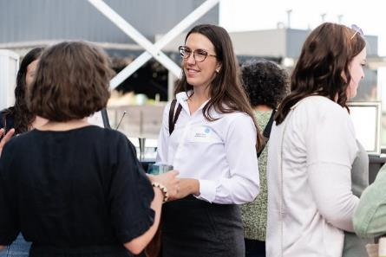
How can I be a valuable board member?
Promote NEWH to others; understand the mission/history.
Understand roles and responsibilities; hold others accountable.
Live your role and responsibilities; hold yourself accountable.
Stay in your lane.
Cross over lanes when asked.
Come prepared (review agenda and supporting documents).
Treat information and discussions as “confidential”.
Be curious about different perspectives/practice teamwork.
Consensus means “I can live with it” and will support it as a team.

Slide 27
Committee do’s & Don’ts
Do:
  Choose members carefully, include non-Board Members for committee service (If you need help recruiting, conduct a member talent survey – contact the NEWH, Inc. Office for info).
  Distribute committee assignments evenly across the Board so all Members are involved.
  Give goals and provide follow-up communication/connect with Committee Members on an ongoing basis to ensure success.
  Get approval from the full Board before making important decisions.
  Write committee reports providing info to Board.
Don’t:
  Create committees that are too large to be effective.
  Treat non-Board Members as outsiders.

Slide 28
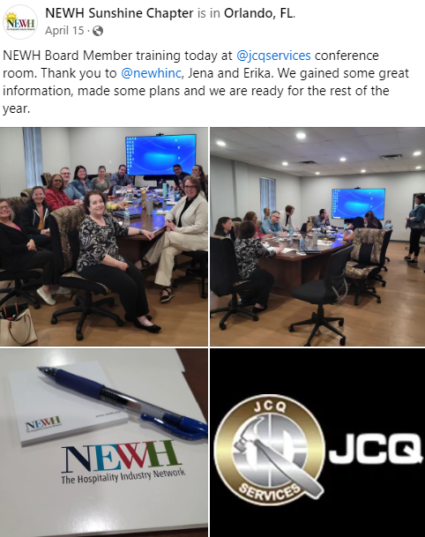
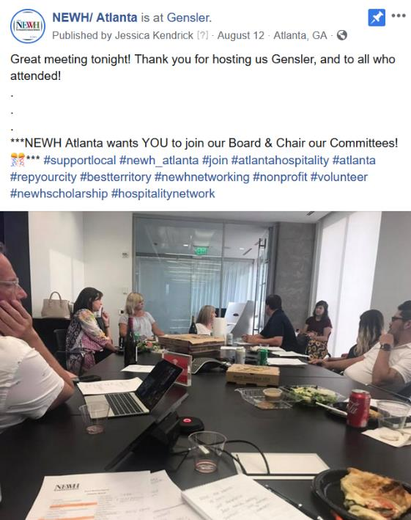

Post your board/committee volunteers hard at work…

Slide 29
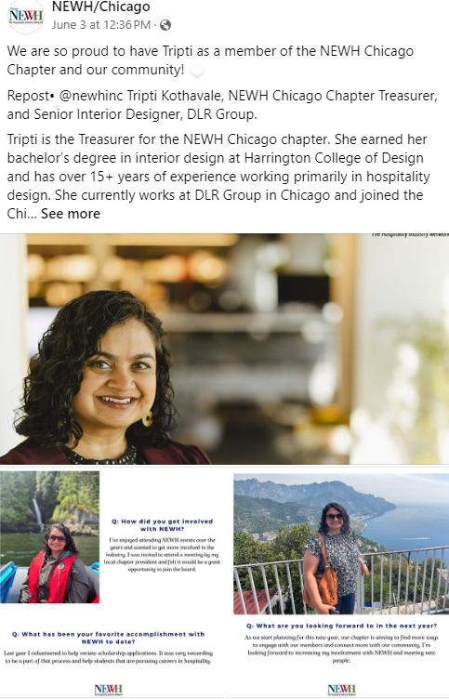
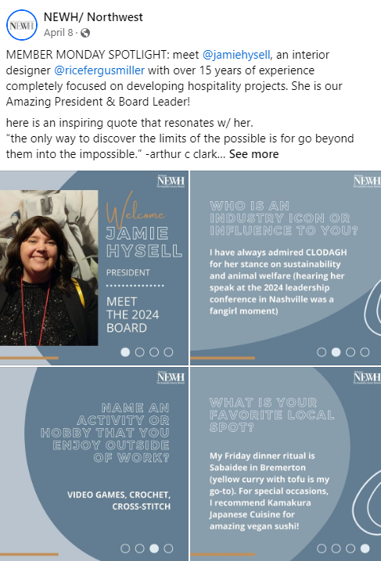
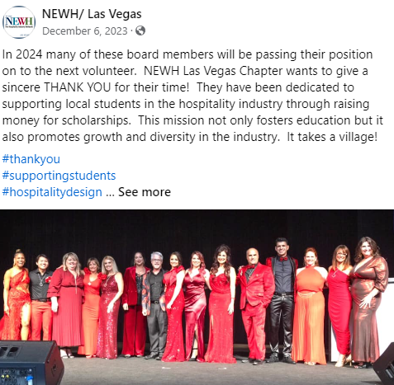
HIGHLIGHT YOUR BOARD MEMBERS AND THANK THEM!

Slide 30

Board Financial responsibilities
The Board should carefully review all financial reports as they have a fiduciary responsibility for all Chapter finances.
The treasurer will present a financial report for the previous period at each monthly meeting.
The Board should prepare, propose, and vote to approve an annual budget. Chapters should not be spending money until a budget has been approved.
The approved budget should be included with the Chapter Business Plan and turned in to NEWH, Inc. Office by end of February. The business plan template can be found on NEWH website.

Slide 31
Financial Notes
All Chapters have 2 bank accounts – Administrative and Scholarship. Checks are ONLY written from the Admin account.
Checkbooks are held at the NEWH, Inc. Office on the Chapter’s behalf.
Scholarship $$’s are NOT to be co-mingled with administrative funds.
Funds transferred from the scholarship account to the admin account to cover the expenditure(s) – Contact Susan Huntington with approved transfer amount and she will complete the bank transfer for you.

Slide 32
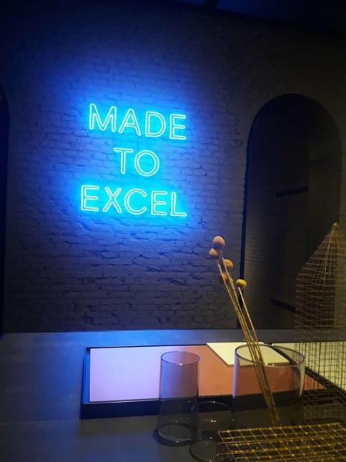
Financial Notes
NEWH, Inc. holds a Chapter credit card for all Chapters to utilize to pay expenses (no fee). This ensures vendors are paid promptly, and Board Members are not using personal finances to pay NEWH expenses. Please submit Chapter requests to Susan Huntington at NEWH.Finance@newh.org
Compliance
  State compliance is conducted through the NEWH, Inc. Office.
  Please check with NEWH, Inc. Office if your Chapter is tax-exempt, we are NOT tax exempt in all states.

Slide 33
Role of the President
The President shall report to the NEWH CEO, Staff and the Chapter the Executive Committee, and shall have general supervision and control over its affairs. The President shall:
  Create meeting agenda and distribute in advance of meeting; solicit agenda items from Board Members.
  Encourage discussion and input from all Board Members.
  Supervise and direct the business of the Chapter, keeping all Board Members focused on setting and meeting the goals of NEWH.
  Encourage future leaders.
  Encourage teamwork and ensure involvement of all members in the Chapter.
The president has no vote – in case of a tie, the president will cast the tie-breaking vote.

Slide 34
Presidents Role in Successful/Productive Meetings*
Start and stop on time (timekeeper is Past President).
Require cell phones off or silenced and put away.
Request one conversation at a time; no sidebar conversations.
Follow Robert’s Rules of Order and NEWH By-laws to maintain order at meetings.
Require meeting attendees to raise hand and be recognized before speaking.
Set time limits on topics.
Create a ‘Parking Lot’ for any discussions that need to be tabled or that get off track of meeting agenda/committee work.
Don’t get involved in personalities, keep the discussion on issues.
Majority vote is the way to make decisions.
  *Chapters are required to hold at least 10 Board of Directors Meetings per year.

Slide 35
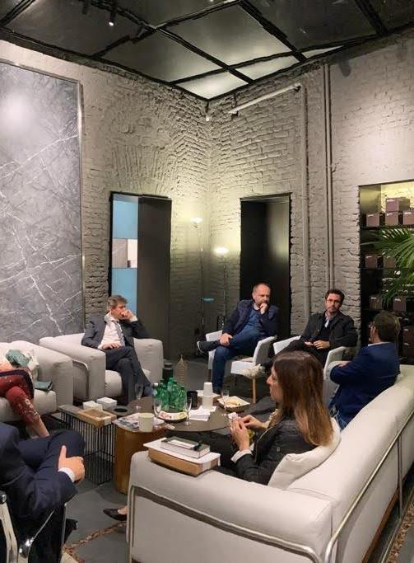
Chapter Business plan
What is a Chapter Business Plan?
A business plan helps ensure your Chapter’s success and outlines the operating framework of your Chapter by dealing with who you are, your plans/goals, and how you will generate proceeds for NEWH’s mission of scholarship and education.
The president should work with the Board Members to create and submit a budget plan for your Chapter by the end of February. (Template located on NEWH website – Board Resources)
What’s included in the business plan?
  List of Board of Directors/Chairs
  Chapter Event Calendar
  Approved Chapter Budget
Other helpful items to include in your business plan:
  Ask each Director/Chair to write 2-3 goals they’d like to complete for the year.
  Conduct a SGOT analysis – refer to this throughout the year and in future strategic planning sessions.

Slide 36
Role of the past president/newh delegate
The Past President/Parliamentarian will:
Serve as parliamentarian and have knowledge of Roberts Rules of Order.
The Past President will serve as a Chapter NEWH Delegate.
The Past President should join a committee(s)!
Serve as the timekeeper of meetings.
Take minutes in the absence of the Secretary.
Preserve all records and correspondence from his/her position, as they belong to the Chapter.
Ensure all Board Members sign code of ethics/conflict of interest form and adhere to NEWH By-laws.
Chair the Nominations Committee.
Attend Chapter Board meetings and Chapter Executive Committee meetings, along with Chapter Board Orientation/Training/Strategic Planning as required/requested.

Slide 37
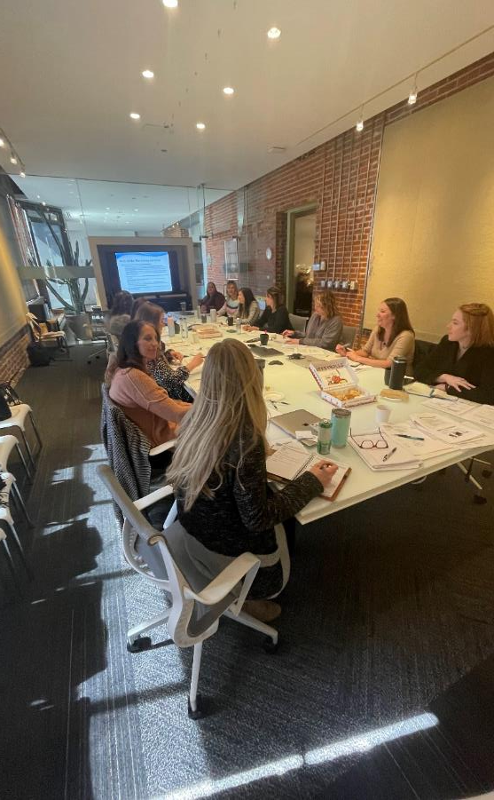
Role of the NEWH Delegate
The VP/Administration and the Past President will serve as the NEWH Delegates.
They shall act as liaison between the Chapter and NEWH, Inc. Board.
All Delegates must attend a minimum of two (2) NEWH, Inc. Board meetings a year – these Board meetings are held 3 times a year (Jan/Feb [required], May/June, and November).
The Delegates are responsible for providing a written report to the NEWH, Inc. Office prior to the NEWH, Inc. Board meeting.
The Delegates provide a written report of the NEWH, Inc. Board meetings to their Chapter the month following a NEWH, Inc. Board meeting.
Submit travel reimbursements within 60 days or they don’t get reimbursed.

Slide 38
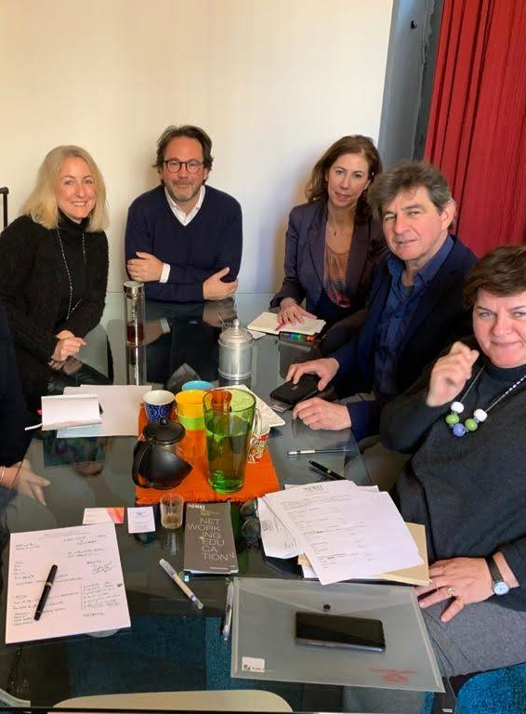
NEWH Reimbursement policy for newh delegates
NEWH has a very conservative travel reimbursement policy.
NEWH will cover ½ of the NEWH, Inc. Board Members and Chapter Delegate’s airfare and ½ of their room expense for two (2) nights max to attend regularly scheduled Board of Directors meetings based on caps provided for airfare and lodging prior to the meeting (if these expenses are not being covered by their business). Chapter covers the other half of airfare/lodging and includes it in annual budget. Room rates are based on double occupancy with qualified Board Members.
  Please note: There are caps on airfare and lodging based on location – Delegates are informed of the caps in the meeting announcement sent by NEWH. NEWH will reimburse up to $50 of additional approved expenses with receipt. An approved expense is transportation or meals (no alcohol).
If, in your normal course of business, you will be attending (or exhibiting at) an event, you should only request the appropriate portion of one-night’s lodging and no airfare.
NEWH, Inc. will not reimburse NEWH, Inc. Board Members (Delegates) travel expenses if they have not turned in their discipline/Chapter/Regional Group Board Report.

Slide 39
Role of the vp-administration/ newh delegate
In the absence or disability of the President, the VP/Admin (President Elect) shall be designated by the Board of Directors to perform all the duties of the President. The VP/Admin oversees:
  Records (Secretary, Historian)
  Finance (Treasurer)
  Education (Scholarship, Green Voice, Mentoring/Education Programs, Equity, Inclusion, and Diversity, CEU)
The VP/Admin will assume the position of President at the end of the current President’s term.
The VP/Admin will serve as the Chapter’s NEWH Delegate.
The VP/Admin should join a committee(s)!

Slide 40
Role of the VP-Development
The VP/Development shall assist the VP/Admin in the performance of his/her duties. In the absence or disability of the VP/Admin, the VP/Development shall assume and perform all duties and obligations of the VP/Admin. The VP/Development oversees:
  Membership (Membership, Strategic Alliances, Farewell Ambassador)
  Marketing (Marketing, Social Media, Community Service, Publications, Public Relations)
  Events (Programming, Fundraising, Hospitality, Regional Tradeshow)
  Development (Student Relations, Committee Development, Strategic Planning, Student Representative)
  TopID Process (Create and oversee the TopID committee and understand the TopID process and timeline to ensure deadlines are met. Participate in TopID committee member calls facilitated by NEWH, Inc. Serve as point person and liaison to the NEWH, Inc. TopID committee.)
The VP/Development should join a committee(s)!
The VP/Development shall automatically assume the position of VP/Administration following their VP/Development term.

Slide 41

Role of the secretary*
Keep minutes of all meetings and actions of Directors, committees of Directors, and Members.
Take roll call and ensure a quorum is established (50% of voting members plus 1).
Minutes are a legal record of the Board Meeting.
Minutes are not a record of side conversations or reminders.
Submit approved minutes to the NEWH, Inc. Office.
If the Secretary cannot attend, ask the Past President to take minutes for you.
Properly store all meeting minutes and Chapter documents (event mailers, program notices, letters, etc.) to ensure historical documentation and legal compliance.
  * It is a legal requirement that all Chapters have a Secretary.

Slide 42
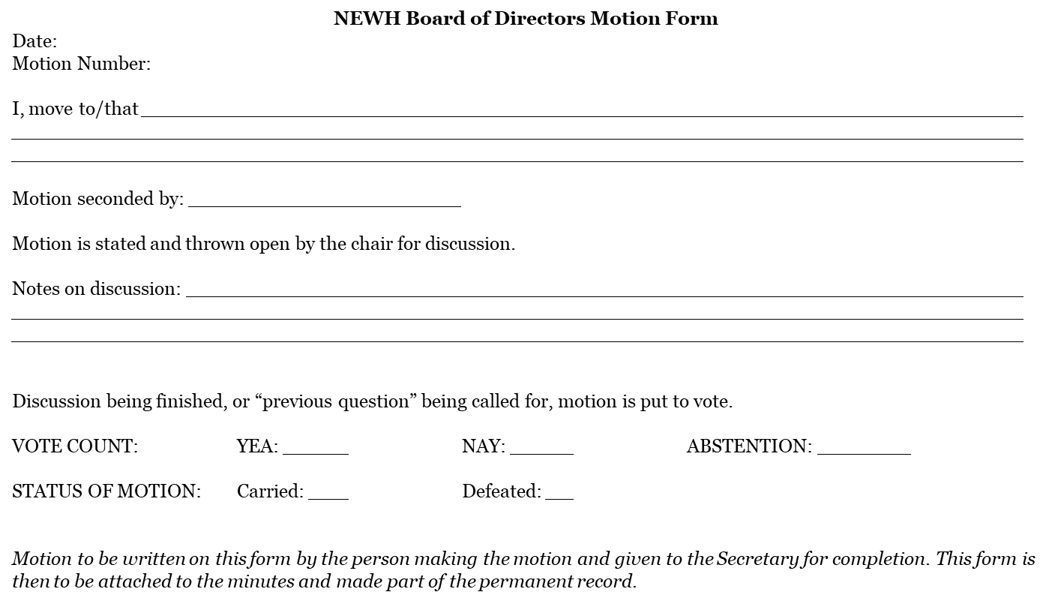
MOTION FORM TEMPLATE

Slide 43
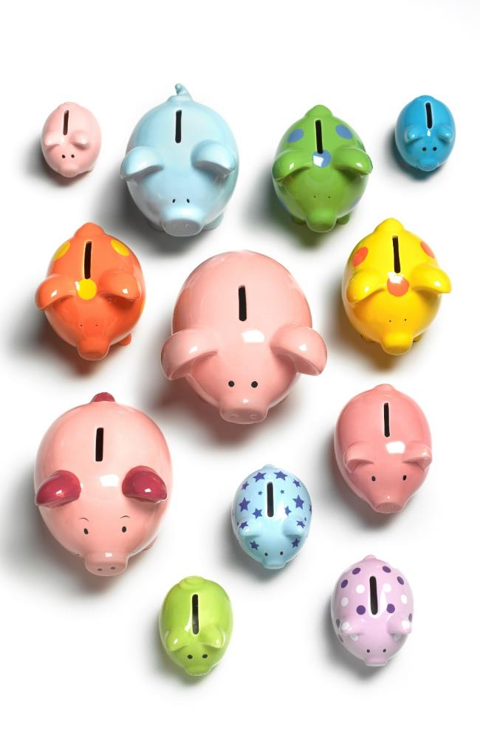
role OF THE TREASURER
The Treasurer shall:
  Keep and maintain, adequate and correct books and records of the business transactions of the Chapter.
  Oversees financial transactions of its assets, liabilities, receipts, and disbursements in the Chapter’s QuickBooks Online account per the established chart of accounts.
  Supports the Programming and Fundraising Directors with event financials such as fund collection/disbursements, invoicing and tracking as approved by the Chapter Board of Directors.
  Provides to the Chapter Board of Directors reports on the financial condition of the Chapter at each monthly Chapter meeting.

Slide 44
Role of the executive advisor
Support the president, be her/his mentor
Help maintain the knowledge base and history on the Chapter Board
The Executive Advisor has no vote
The Executive Advisor should join a committee(s)!

Slide 45
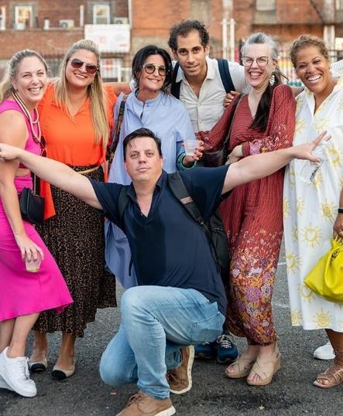
Role of membership director
The Membership Director will:
  Actively recruit new members for the Chapter.
  With Programming Director, coordinate and implement at least one Chapter event as a “Membership Drive”.
  Ensure NEWH information (brochures, applications, etc.) is available at events for potential members.
  Encourage prospective new members by calling/emailing them to answer any questions and encourage them to Join Online.
  Call/email new members within 5 business days of approval welcoming them to your Chapter and informing them of future Chapter events.
  Forward all original approved applications and payments to NEWH, Inc. within 30 days of application – review online applications with Board and submit approvals to NEWH, Inc. within 30 days of application – NEWH, Inc. will mail new member packets.
  Introduce or recognize all new members at Chapter events.
  Throughout the year, chair the membership renewal committee, calling all members who have not renewed as well as those whose membership is due in the upcoming month.
  Maintain existing members – with committee members, call/email current and recently lapsed members urging them to renew their dues.
  Keep Chapter mailing list current by forwarding any new or revised contact information to the NEWH, Inc. Office to update your master list.

Slide 46
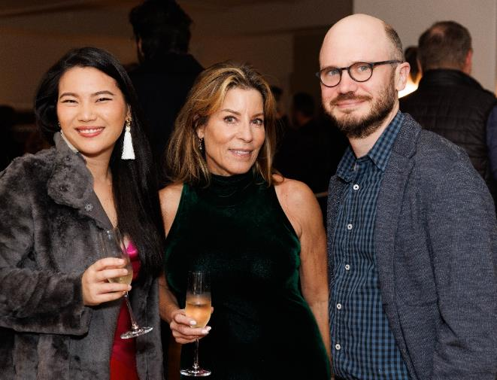
Membership levels
General Member – open to professionals who have been actively involved in Hospitality or a related field for one or more years.
Associate Member – open to those industry members who have, within a 12-month period, completed an accredited area of hospitality related studies. The Associate Membership category will be available to these members for three (3) years. Associate Member cannot hold an elected office but are encouraged to serve on Chapter Board Committees. ($50 membership)
Education Professional Member – those who are full time educators of Hospitality–Related Studies. (Free membership)
Student Member – those who are enrolled in an accredited place of secondary education, majoring in Hospitality related studies. Student Members will receive one year of free Associate Membership upon graduation in order to facilitate the transition to General Membership. (Free membership)
Retiree – those who are retired and 65 years or older. (Half-off dues)

Slide 47
Business membership levels
Business PLUS – $7,500
The Business PLUS Membership belongs to the business and includes 20 members (national/international), and up to 10 additional discounted memberships. Additionally, this membership category includes:
  One (1) guaranteed regional tradeshow placement over a two-year period (not including the actual tradeshow fee).
  A one-quarter page ad in NEWH Magazine.
  Unlimited courtesy listings in the NEWH Career Network.
  Company listing in the Member Directory and Member Directory, and premium listing in the Resource Directory (includes logo and 4 product/installation images).

Slide 48
Business Membership Levels continued
Chapter Level Business (CLB) Member – $425 ($500 CAD, £300)
  This is the perfect membership for those businesses that have more than one employee at the same geographic location who are interested in joining the local Chapter.
  Membership belongs to the business and includes 2 courtesy memberships and up to 4 additional discount memberships ($75 US; $91 CAD; £60 UK).
  All employees of CLB can attend primary Chapter programming events at member ticket cost (excludes fundraising events).
  Marketing benefits – premium listing in Resource Directory (includes logo and 4 product/installation images) and listed in Business Member Directory.
CLB Member – TOP TIER $1,000 ($1200 CAD, £700)
  Top Tier Membership enjoys the same benefits as the Chapter Level Business but includes 6 courtesy and up to 6 discount memberships.

Slide 49
Corporate Partners
Corporate Partner Courtesy and Discount Member
  Each Corporate Partner level includes a number of Courtesy Memberships (chosen by the corporate partner) as well as a number of discount memberships. Corporate Partner Memberships are not voted on but rather approved due to their approved partnership.
NEWH has 3 levels of NEWH Corporate Partnership ($18,000-$38,500 per year). Within each level the company receives a certain amount of courtesy as well as discounted memberships to allocate as the main contact chooses. This is not per Chapter.
Supporting Level - 25 partners
  Receives 5 Courtesy Memberships and up to 5 more at a discounted rate.
Patron - 10 partners
  Receives 10 Courtesy Memberships and up to 10 more at a discounted rate.
Benefactor - 5 partners
  Receives 20 Courtesy Memberships and up to 20 more at a discounted rate.
Any questions from a potential member on receiving either a courtesy or discounted membership from their company should be emailed to jena.seibel@newh.org. Jena will contact the main decision maker for the partnership to find out what is available.

Slide 50


Ways to show member value
Events
offer member tickets at a lower cost or free
offer event tickets to members first for highly coveted programs, or those events with limited capacity
offer event sponsorships to members first or offer sponsorship discount to members
offer members the opportunity to be a panelist, provide a tour of a new or renovated space, or host a showroom event or educational event (CEU)
hold a members-only drawing at your events
Marketing
post member news on chapter social media sites, NEWH Magazine, chapter website, and chapter publications (new positions, new products – provide link to company website)
create a member spotlight on your chapter page, highlighting a member each month
recognize your chapter’s Top ID recipients on social media and publications
identify members at your event with a member ribbon or sticker – make them feel special!
Networking/Leadership Opportunities
access to NEWH member directory to facilitate introductions and one-on-one networking
ability to serve on your chapter board in a leadership position
access to top level emerging talent through schools, scholarship recipients, and education professionals

Slide 51
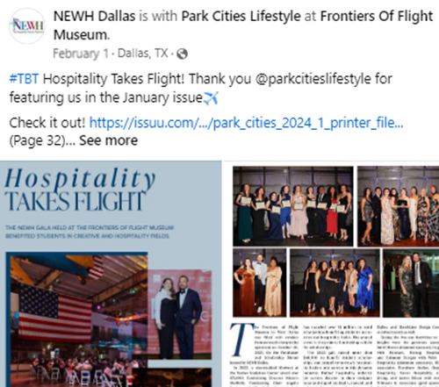
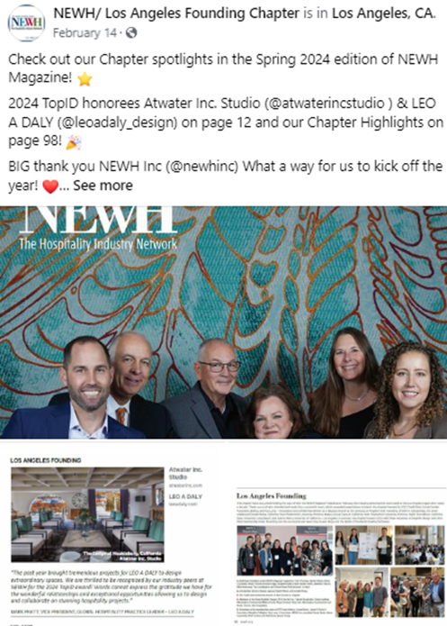
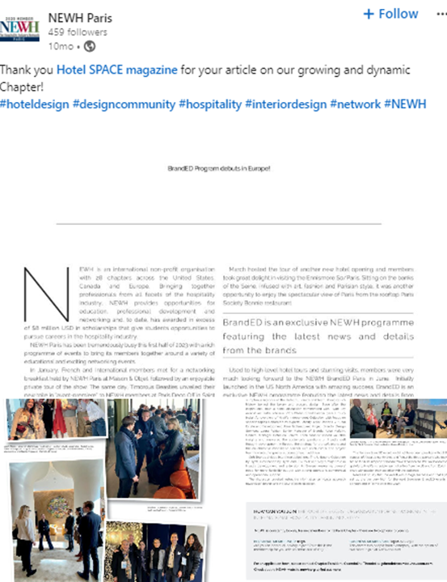
Take every opportunity to promote your members…member news in the NEWH Magazine, member spotlights on your website, or post news on facebook

Slide 52
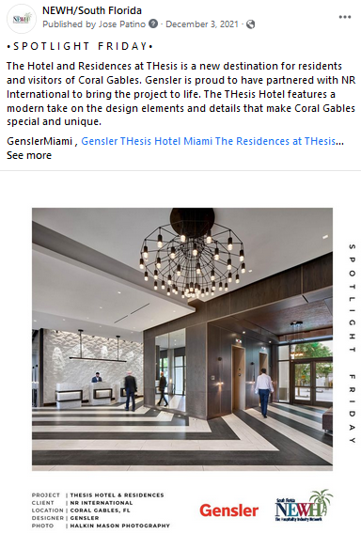

Highlight your local design firms on social media…
Idea: Firm Friday!

Slide 53
More ideas to promote members – highlight your TopIDs on social media!

Slide 54
Role of the Student Relations Director
The Student Relations Director will:
  Enlist Student Relations Committee Members, including student representatives from surrounding schools.
  Connect with local universities and colleges who have Hospitality related studies and market NEWH to its student members, sharing the benefits of being involved and a member of NEWH.
  Build relationships with current student members.
  With Programming Director, plan a student-based event (resume reviews, speed networking, student centric events).
  Enlist and utilize students as volunteers for Chapter events.
  Communicate scholarship opportunities and application timeline to your Chapter school list – follow up with scholarship applicants and recipients encouraging them to become student members.
  Collect updated contact information with current student members prior to graduation in order to maintain relationships with them as they transition to associate members.

Slide 55

Role of the Equity, Inclusion, and Diversity Director
The Equity, Inclusion, and Diversity Director will:
  Enhance, bring awareness, and educate the Chapter Board and NEWH community on diversity.
  Present to the Chapter Board various opportunities to promote equity, inclusion, and diversity within the hospitality industry.
  Diversity Director and Committee will ensure fundraising, programming, and community service events align with NEWH's pledge for diversity in our communities.
  Act as a liaison between the Chapter and NEWH Diversity Committee.

Slide 56
The role of the marketing director
The Marketing Director responsibilities:
  Bring the message of the NEWH Chapter to the hospitality industry in a consistent and unified manner. The Marketing Director and his/her committee will be responsible for managing all external communications of the Chapter.
  Ensure all marketing initiatives are developed and designed to reflect NEWH’s overall mission and the message is unified and consistent with the goals and objectives of NEWH.
  Ensure that NEWH brand standards/policies are met on all marketing collateral distributed.
  Develop Chapter marketing initiatives that will build brand awareness and further promote NEWH’s mission.
  Market Chapter’s approved calendar of events – ensuring information is submitted to NEWH, Inc. Office for inclusion on website, posted on social media sites, and shared with potential sponsors.
  Ensure Chapter information is appropriately submitted in a timely manner for the NEWH Magazine.

Slide 57
Can our chapter have our own
Website?
  Chapters are NOT allowed to have their own websites – specifically for their Chapter or for a special event.
  There are legal ramifications to everything we do, everything we say, everything we print…things that would very easily make us lose our tax-exempt status.
  The thing that has made NEWH successful for the past 30 years is:
ONE Brand
One Voice
One Mission
One Vision
One Organization

Slide 58

Role of the Social Media chair
The Social Media Chair will:
  Ensure event notices, Chapter news, event photos, etc. are posted to NEWH Chapter pages, Chapter Facebook page, Instagram and LinkedIn in a timely manner.
  Upload event pictures to Flickr and Facebook to ensure NEWH website page includes recent event photos.
  Introduce/Post new members via Facebook along with their company logo!
  Ensure Chapter page is current and contains viable information (i.e., event recaps, member news, sustainable info, scholarship info, etc.).
  Note: All posts to the Chapter’s Facebook page are automatically tweeted on the NEWH, Inc. Twitter account…so you are getting double exposure for your efforts. Chapters are encouraged to open their own LinkedIn page if desired.

Slide 59

Be creative in promoting your events – build up excitement!

Slide 60
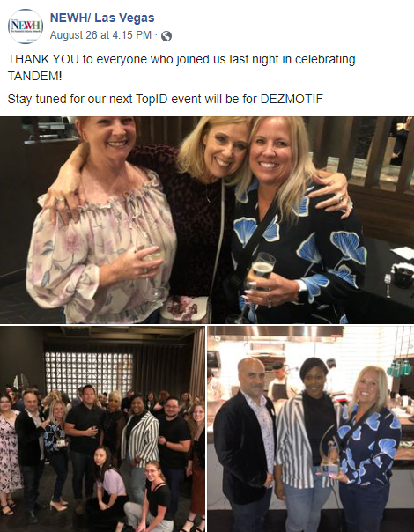
People LOVE to see pictures from your events!

Slide 61
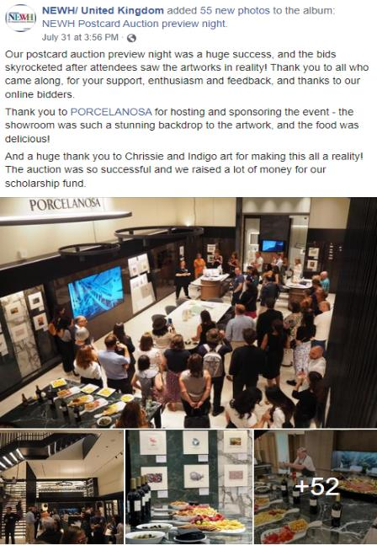
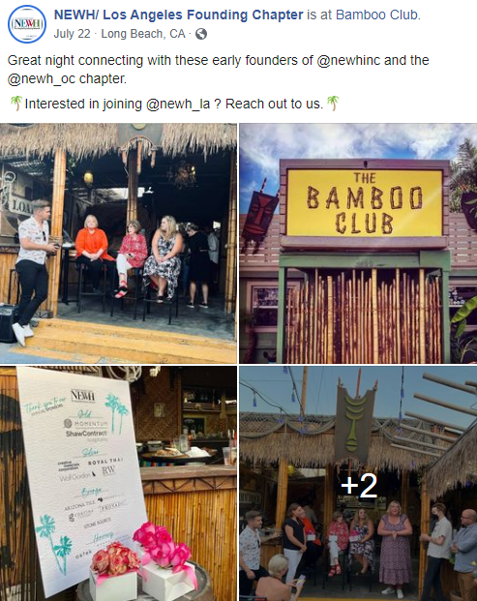
Post lots of pictures…show people what they missed!

Slide 62



Thank your sponsors
Send a Thank You Letter
Thank sponsors on social media BEFORE the event
And…AFTER the event
Include:
The NEWH, Inc. Tax ID Number.
Any goods and services the sponsor received for their donation, along with the FAIR MARKET VALUE of the goods and services received (template available on the NEWH website).

Slide 63

Use Instagram to raise awareness of NEWH!
Post pictures of members
Post quotes that relate to our mission statement
Tell a short story
Hold contests
Thank event sponsors (include sponsor logo)
Post meeting notices on Instagram
Post event wrap-up photos (i.e., ‘look what you missed’)
Promote one member per month
Highlight TopIDs
Highlight scholarship recipients
Establish a ‘thankful Thursday’ or ‘Board Member Monday’ to highlight members
*see Instagram guidelines in Board Resources on website

Slide 64
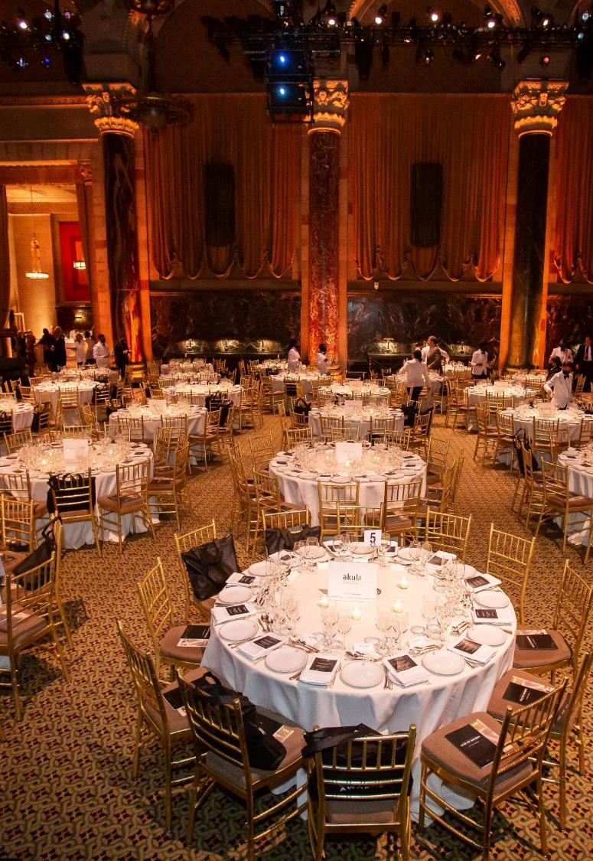
Role of the public relations chair
The Public Relations Chair will:
  Act as a liaison between the Chapter and news organizations supplying articles of interest, photos, fundraising events, and other related material to the media.
  Promote NEWH within the industry and the organization.

Slide 65
Role of the publications chair:
The Publications Chair will:
  Handle all printed and electronic materials of the Chapter – order elevator cards or brochures through the NEWH website (final approval by president).
  Develop newsletter published and mailed by the Chapter – determine with Board how many publications there will be and how they will be published and financed.
  Submit information to NEWH for your Chapter page on the NEWH website.
  Submit to NEWH any articles, photographs, or newsworthy items for inclusion in the NEWH Magazine in a timely manner.

Slide 66
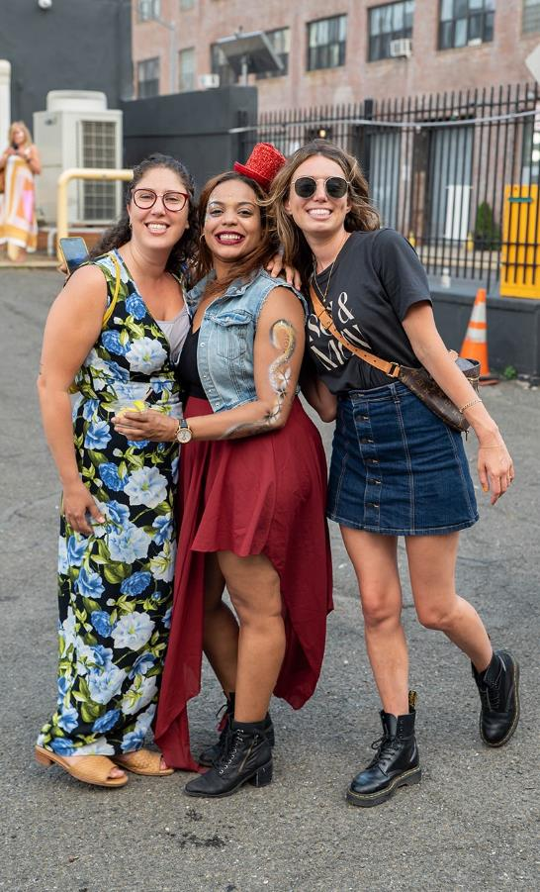
What is the difference between a program and fundraising event?
What type of event did you hold?
Was it FUN – was it a FUN party? NEWH doesn’t throw parties unless they are FUNdraisers.
Did you have a speaker, a panel discussion, a tour, did industry members find your event informative and educational? You just held a Program.
A FUNdraiser’s purpose is to raise money for Scholarship and Education– the event proceeds must be a minimum of 40%. A program’s purpose is to network and build membership and should cover its costs and may have minimal proceeds of 5 – 10%.
Happy Hour events are neither a program or a FUNdraiser, they are not required to have any proceeds, no speakers or tours are necessary. You have not contracted with a venue to provide a special room, etc. for a Happy Hour type event.
Note on Raffles/Auctions – total dollars taken in for a raffle/auction is not included into your total income for a programming event - these are fundraising dollars and need to be reported to NEWH, Inc.
  Be sure to know your state/county guidelines regarding raffles (contact Susan Huntington in the NEWH, Inc. Office to help with that).

Slide 67

Role of Programming Director
The Programming Director will:
  Plan and implement each general meeting/event.
  With your programming chair/committee, develop a calendar of events for the year to be voted/approved by the Board. Aim for high-quality educational events your members will want to attend.
  Prepare a budget for each event to be approved by the Board – gather sponsorships to underwrite events.
  Provide results of Activity Report to Board after each meeting and submit that to NEWH, Inc. within 45 days of event.

Slide 68

Insurance Coverages
Errors and Omissions - covers the actions of the leadership, for example antitrust violations, etc. – this is provided to each Chapter by the NEWH, Inc. Office.
Certificate of Insurance (COI) – covers event liability – this is the responsibility of your Chapter per event. Confirm with your venue if a COI is required to be on file for the event. Each certificate of insurance is $50. Contact Susan Huntington in the NEWH, Inc. Office 3 weeks prior to event to obtain a certificate.
Chapters are required to purchase a certificate of insurance on an individual basis through NEWH for any NEWH sponsored event (it is not required for your monthly social events – i.e., Toasty Tuesdays, Thirsty Thursdays, Happy hours, etc. that take place in a bar/restaurant).

Slide 69

NEWH Liquor Policy
The purpose of this general policy is to establish appropriate guidelines to protect Chapters and NEWH from potential legal action associated with alcohol consumption at NEWH sponsored events.
If at any level NEWH serves alcohol, or sponsors, co-sponsors or participates in an event where alcohol is served, NEWH may be at risk of liability for claims arising from the conduct of persons who are intoxicated by alcohol served at the event.
Event venues must carry insurance and the Chapter should obtain a copy of insurance from the event venue prior to the event.
The certificate of insurance is only liability insurance, not host liquor liability which is a completely different policy.

Slide 70
NEWH Liquor Policy Guidelines
Do not allow continued service of alcoholic beverages to intoxicated individuals.
Obtain the appropriate certificate of insurance and copy of host liquor liability insurance for all applicable events.
Avoid “Open Bar”.
Engage licensed professional Servers who are trained in responsible alcohol service, either as a third party or through the hotel or event facility where your event is located. Only the professional/licensed Servers should provide, serve and sell the liquor being consumed. NEWH Members/Nonmembers or anyone representing NEWH should not be serving alcohol at an event.
Verify and comply with any State or local laws requiring licensing, training or certification for Servers of alcoholic beverages.
Request that your Server or event venue provide a copy of their host liquor liability insurance, and request that NEWH be named as an additional insured party.

Slide 71

NEWH Event Refund/Cancellation Policy
‘See Terms & Conditions’ is in the footer of all checkout forms and states:
Event Cancellation by NEWH
NEWH and its Chapters reserve the right to cancel an event due to low enrollment or other circumstances which would make the event non-viable.
If NEWH or its Chapters cancels an event, registrants will be offered a full refund.
Should circumstances arise that result in the postponement of an event, registrants will have the option to either receive a full refund or transfer registration to the same event at the new, future date.
Registration Cancellation by Sponsor
Unless specifically stated on sponsorship materials, the policy to receive a refund for your sponsorship is:
30 days prior to the event – no refund
within 45 days of event 50% refund
within 60 days 75% refund
within 120 days full refund

Slide 72
NEWH Event Refund/Cancellation Policy continued
Registration Cancellation by Participant
Unless specifically stated on registration materials, the deadline to receive a refund for your event registration is:
Programming events: 10 days before the event for full refund
Fundraising events: No refund/non-refundable tickets
Cancellations received after the stated deadline will not be eligible for a refund.
Refunds will not be available for registrants who choose not to attend an event.
Cancellations will be accepted via phone, fax or e-mail, and must be received by the stated cancellation deadline.
All refund requests must be made by the attendee or credit card holder.
Refund requests must include the name of the attendee and/or transaction number.
Refunds will be credited back to the original credit card used for payment less any applicable credit card fees.
These above policies apply to all NEWH* and its Chapter Events unless otherwise noted in the corresponding event materials. Please read all individual event information thoroughly.

Slide 73
Role of the Fundraising Director
The Fundraising Director will:
Organize the annual fundraising event – determine the theme, budget, location and all details that pertain to the event.
Each Chapter is required to have at least one annual FR event.
Present the Fundraising budget to the Board for approval, ensuring adequate funds will be raised. Your fundraiser should be a profitable endeavor and target minimum 40% in net proceeds.
Of your total net proceeds, 20% goes to NEWH, Inc., and a minimum of 65% of the remaining proceeds goes to your scholarship fund, with the remainder to admin account.
Provide final Results of Activity Report to Board after the fundraiser and submit that final report to NEWH, Inc. Office withing 90 days of the event.

Slide 74
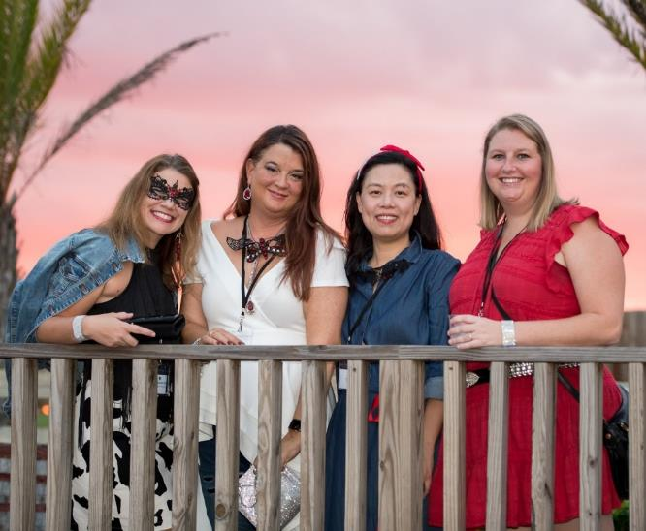
Role of the Hospitality Chair
The Hospitality Chair will:
  Handle the “check-in” at meetings/events - enlist assistance from members (or students).
  Have member roster available at hospitality table for members to update their contact information.
  Be sure corporate partner sign is displayed at all events.
  Other banners to display could include TopID, scholarship banner, event sponsor signage, etc.

Slide 75
Role of the scholarship director
Scholarship Director will:
  Engage students: schedule college visits, offer student/educator events, encourage student representative participation.
  Post Chapter scholarship and event details on college social media sites, share with student groups and financial aid offices.
  Utilize NEWH Scholarship Stories video at school visits, Chapter fundraiser/gala (see guidelines).
  Encourage scholarship recipients to submit photos or selfie videos telling how NEWH has impacted their life (see guidelines-submit to NEWH, Inc.).
  Promote scholarship and student/educator membership (Students and full-time educators receive FREE student membership).
  NEWH also offers industry visibility, leadership skills, social and educational events.
  Highlight school visits, scholarship events and recipients through the NEWH Magazine, Chapter webpage and social media.

Slide 76
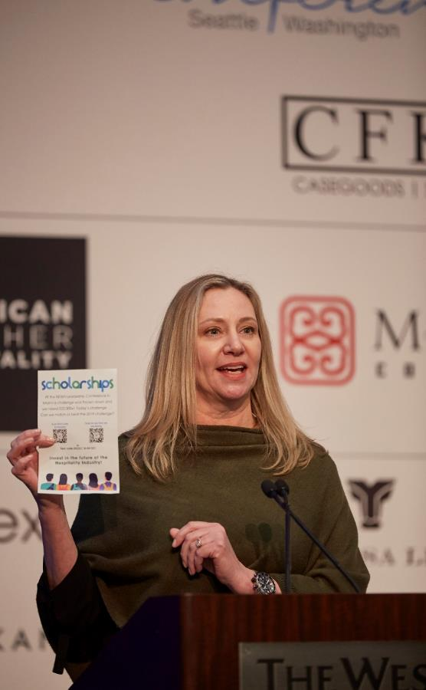
Role of the scholarship director Continued
Scholarship Director – forms and responsibilities
  Determine funds to be awarded. Fundraising dollars raised this year will be applied to the following year’s scholarships. At the beginning of the year, discuss with your Board: scholarship release and deadline date, scholarship awards event (work with Programming Director).
  Update school list and scholarship materials sent by NEWH, Inc.
  NEWH distributes Chapter scholarships to educators through email and mail and via email to student members.
  Applications are submitted to Scholarship Director; a committee is formed to review applications and select winners.
  Within 30-days of application deadline:
    Email all applicants-winners and non-winners (template letters available).
    Submit signed Check Request Form, winning applications and headshots for each student to NEWH, Inc.
    NEWH, Inc. will create scholarship certificates for your awards event and process scholarship checks (checks are payable to college and mailed directly to college).

Slide 77
Congratulate and highlight your scholarship recipients on social media!

Slide 78
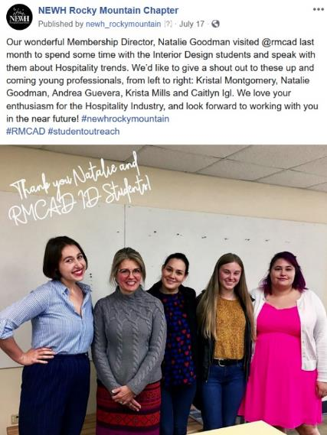
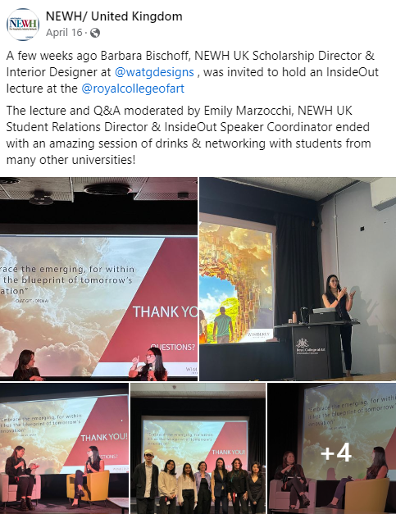
Share on social media how you are reaching out to students!

Slide 79
Role of the green voice chair
The Green Voice Chair will:
Promote consistent message of NEWH Green Voice events and sustainable practices into ongoing events.
  Programming: Develop relevant programming and educational events. Partner with a local Fitwel Ambassador, USGBC or AIA group for an educational event, hold a LEED hotel tour or a roundtable CEU event on environment, health or social equity topics.
  Membership: Recruit sustainable members or companies.
  Community Service: Local SCRAPS event, in-cycle program, clean-up project at a local park, recycling event.
  Publications/Social Media: Monthly green tip email/newsletter to membership, promote NEWH Green Voice events.
  Student Reps: Share NEWH Green Voice Design Competition scholarship with colleges, student groups and through social media.
  @NEWHGreenVoice @NEWHGreenVoiceDesignCompetition #newhgreenvoice

Slide 80


Green voice
Promote NEWH. Green Voice to your Chapter
Board, Members, Educators, Students:
  NEWH Green Voice:
    30-minute powerful conversations held annually at BDNY and HD Expo
    Topics on wellness, environment, health and social equity
    Quarterly Green Voice article in NEWH Magazine
  Link for more details: https://newh.org/education/
NEWH Green Voice Design Competition:
  Annual design competition
  Undergraduate and graduate students may apply
  Instructors may use the project as a class project
  Competition criteria changes annually
  Winners: one (1) undergraduate and one (1) graduate receive a $7,500 scholarship and airfare/lodging to awards event at BDNY
  https://newh.org/scholarship/green-voice-design-competition/

Slide 81
Role of the community service chair
The Community Service chair will:
  Present to the Chapter Board various opportunities the Chapter may select from to serve the community.
  Once the Board has elected a charitable endeavor, the Community Service Chair will form a committee and see it through fruition, NO NEWH dollars can be spent on community service projects.
  No community event dollars can be put in or taken out of an NEWH account.

Slide 82
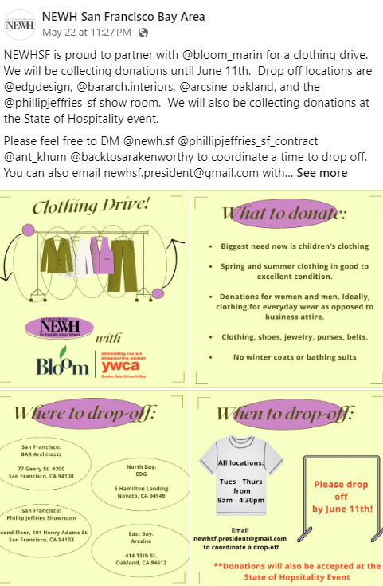

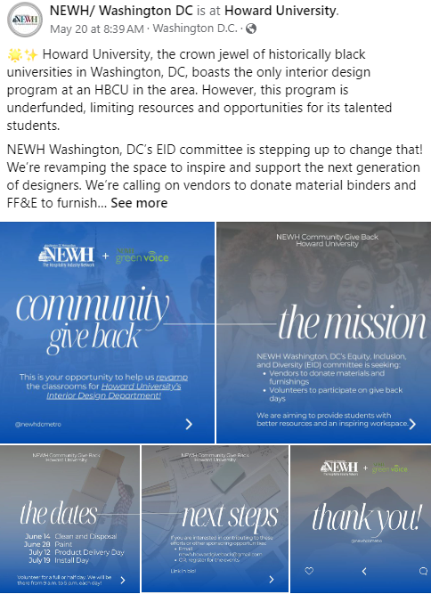
Share your community service/outreach events on social media!

Slide 83
Other chair positions (optional)
    By-laws & Ethics – ensures all Steering Committee Members are familiar with the NEWH By-laws and Ethics
    CEU – supports Programming Chair in researching available CEUs to offer at general meetings
    Committee Development – ascertain members’ talents and interests and solicits them to serve on a committee
    Community Service – coordinates community service events
Database – charged with updating the Region’s mailing/email list (given to them by NEWH, Inc.)
    Education – works with Scholarship Chair on outreach to higher education schools who have hospitality programs
    Education Advisor – this would be an educator
Farewell Ambassador – communicates with past members on reasons why they left the Region in hopes of improving member retention
Historian – Keep all written documents, Region news articles, literature, event invitations, photographs, etc. for historical documentation of your Region
Green Voice – promotes Green Voice events and brings sustainable hospitality education and events to the Region
Public Relations – liaison between the Region and local news organization
Publications – liaison between the Region and the local news organizations, promoting NEWH
Regional Tradeshow – works with NEWH, Inc. Tradeshow Chair and Coordinator to plan regional tradeshow hosted by the Region
Social Media – handles social media and NEWH website updates
Sponsorship/Partner Engagement – ensure that sponsors receive promised sponsor benefits
Strategic Alliances - charged with working with other associations or like groups to develop programs or other offerings that would benefit NEWH and its members
Strategic Planning – works with NEWH, Inc. in offering annual strategic planning session and Steering Committee Training to the Region and helps develop the Region’s annual strategic plan
Student Representative – helps bring the educational community closer to the Region

Slide 84
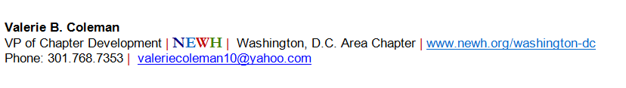

Another way to promote newh…and yourself!
Create an email footer for NEWH-related emails you send:

Slide 85
Mandatory Discipline Training Review (Jan-Feb) for EC and Director Positions
These discipline training reviews will:
Review your Board position responsibilities and accountabilities in detail.
Give you an opportunity to formulate and submit questions regarding your specific position.
Establish a relationship with the NEWH, Inc. staff ‘go-to person’ for your particular position.
ALL BOARD MEMBERS MUST COMPLETE THE MANDATORY DISCIPLINE TRAINING REVIEW:
A link to the discipline training review will be provided to each Board Member for his/her specific position.
The training should be completed by the end of February.
The Board Member will be required to answer questions during the training and submit his/her answers to confirm training completion.

Slide 86



Slide 87

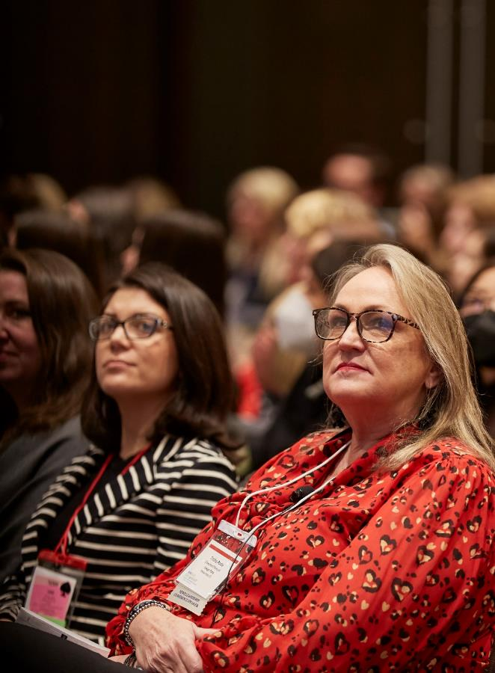
The 2024 NEWH Leadership Conference in Nashville was a smashing success! Check out the recap on the NEWH website – pictures coming soon!

Slide 88
For more information, visit our website!
www.newh.org
Check it out for Chapter happenings, membership information, Resource Directory, scholarship materials, Career Network and MORE!

Slide 89



Board resources on newh.org
Make your job easier! Check out all the forms/templates available to Board Members on the NEWH website.
Login to the website – top menu (Contact the NEWH, Inc. Office if you have problems logging in)
At bottom of homepage in red area, click on NEWH Board Resources

Slide 90

Thank you for serving!
The Board experience should be a positive one.
The Board is the caretaker of the organization.
The Board speaks as a whole - no Board Member should have more input or authority than others.
Always ask questions as they arise.

