Slide 1

Understanding Scholarship Applications

Slide 2

The scholarship Application Review Committee and the Process
The role of the Scholarship Committee member is to assist the Scholarship Director with the review of applications and subsequent awarding of the scholarships to a deserving student. This is an awarding journey that brings such joy to those who find themselves in this role.
NEWH’s main goal as a non-profit is to provide students with the much-needed support and to support to the next generation of designers, culinary and hospitality management positions. This document will share some helpful tips to help accomplish the goals.
Each year, the local Chapters and Regions will select a student (or students) that has a significant amount of need in terms of debt due to their schooling. As a Chapter/Region, it is our job to determine this need and provide scholarships for local students. We use a rating system to provide a score to each of the applications and those with the highest scores receive the scholarships or move onto the next round of review by the Chapter/Region Boards.

Slide 3
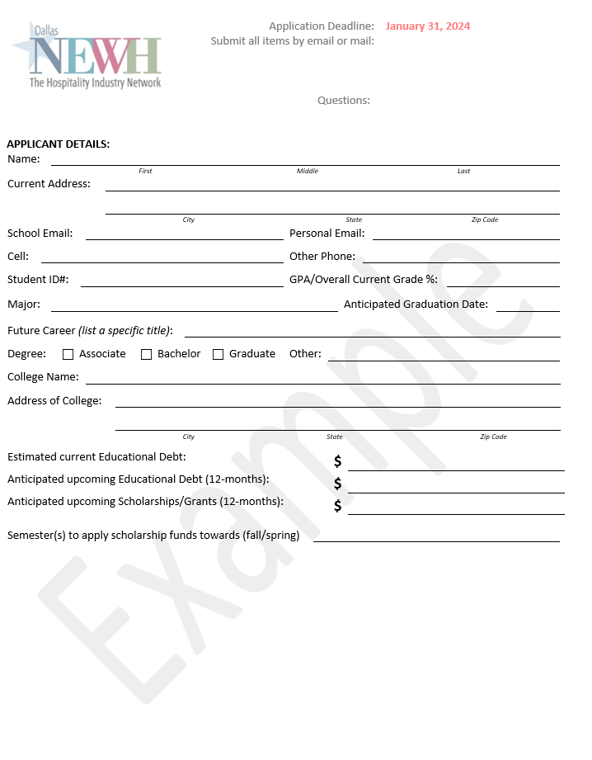
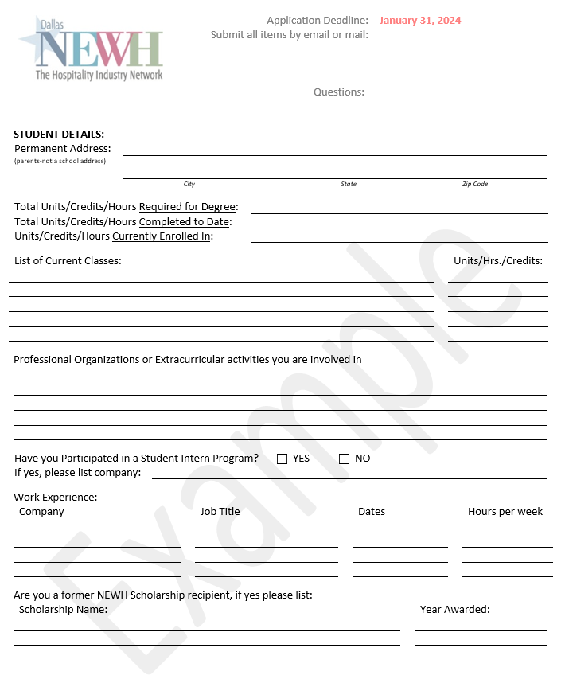
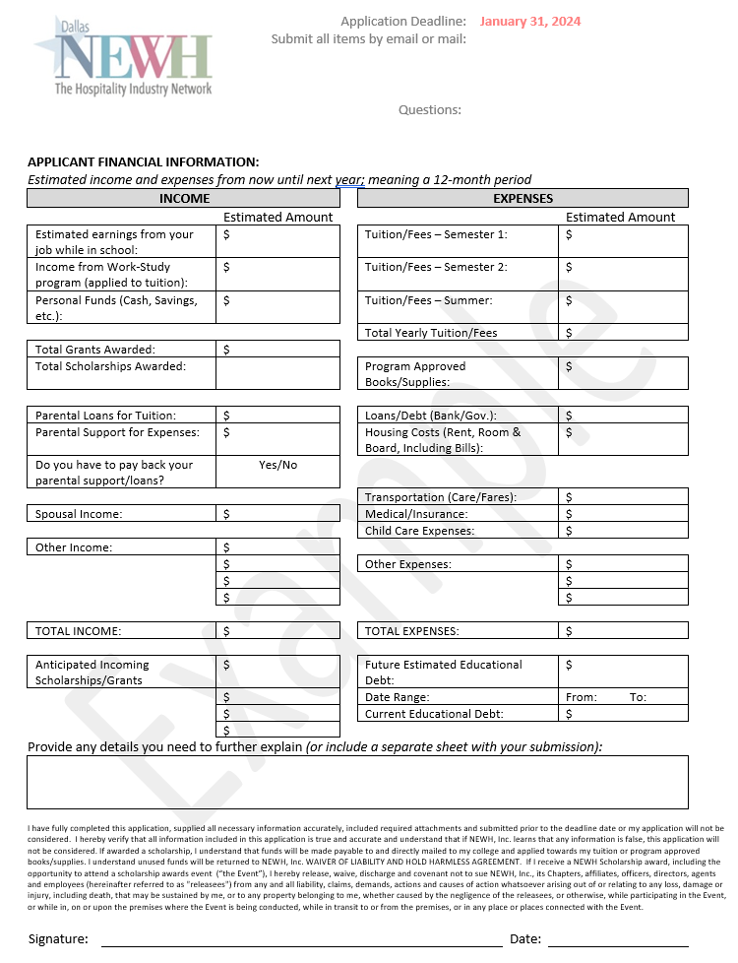
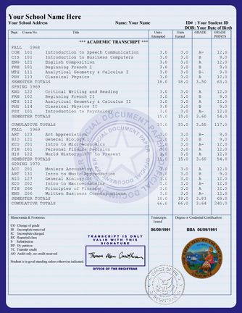
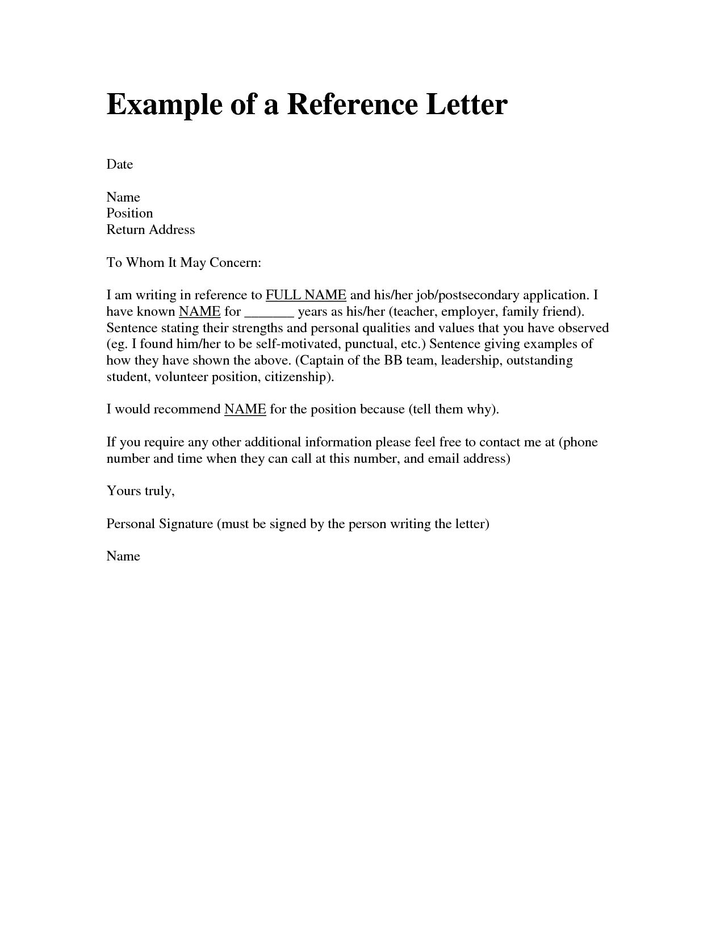
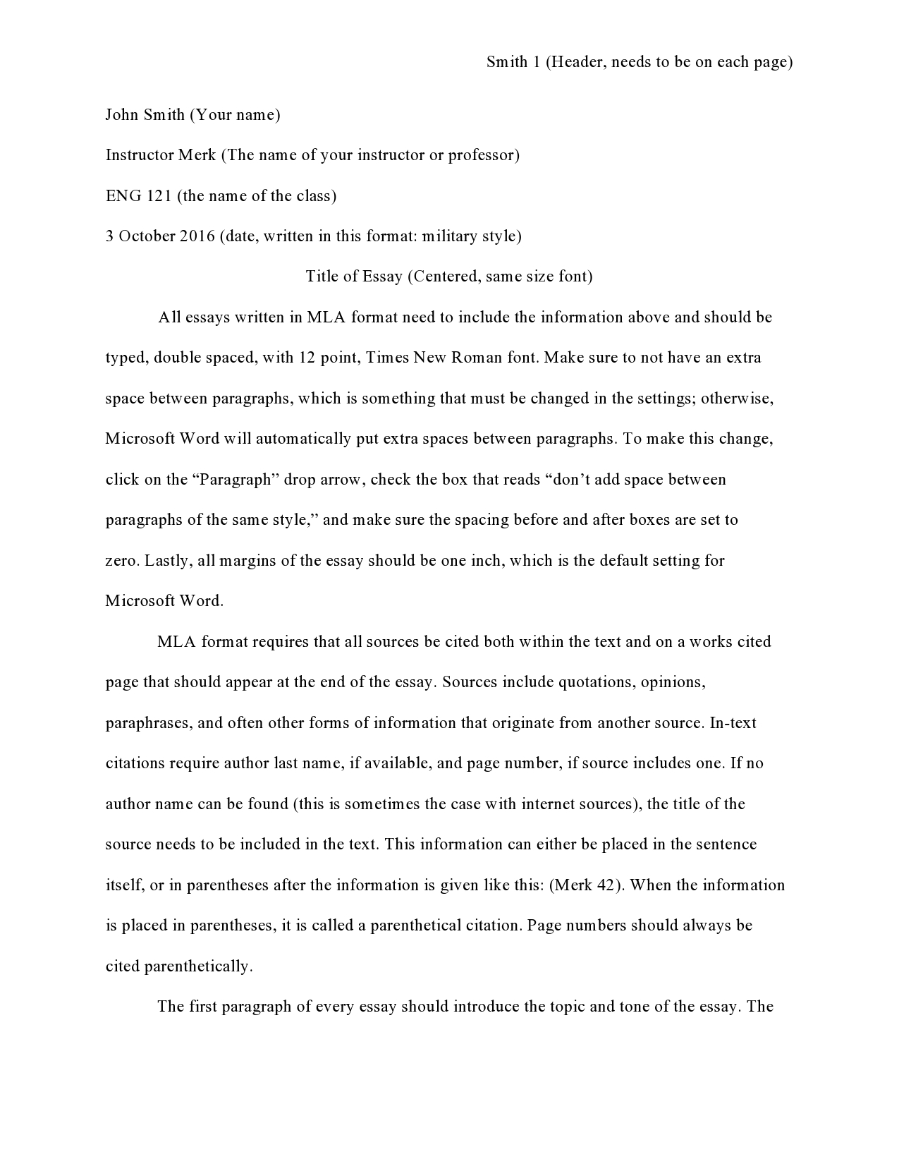

Getting Organized and setting Expectations
In a short period of time, the Scholarship Director will begin to receive scholarship applications in a variety of formats. It is very important to be organized ahead of time since there are a lot of moving pieces. Some applicants will have all their required materials in one email, while others you will need to chase.
Example of Complete Application
Application (Pg. 1)
Application (Pg. 2)
Financial Form
Example
Example
Example
Official Transcript
Reference Letters (1-3)
Essay

Slide 4
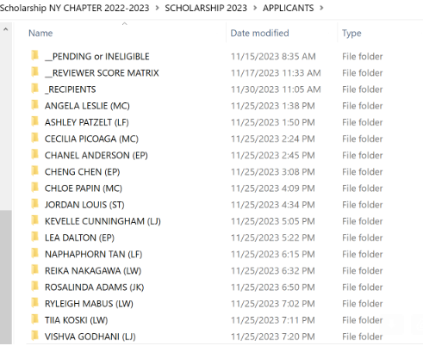
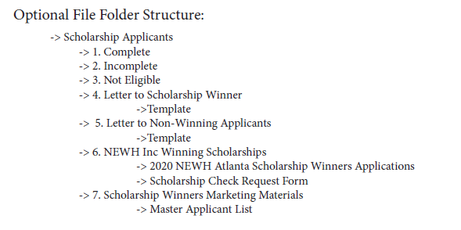
Making a list and checking it twice
TIP: Don’t wait until the last minute to confirm if a student has sent all the required items. Sometimes they don’t know that their professor didn’t send a recommendation letter or their transcripts, and it can take a lot of time to gather it. We don’t want them to lose out on the opportunity. Follow up early and often.

Slide 5
Application Review Process
Each committee member to review a portion of the applications and review them based on the rating system.
Within the reviewer’s folder, you should provide the following information (also available on NEWH.org) to help with review:
  Excel grading rubric of all their students they are reviewing
  Applications FAQ’s
  Sample Scholarship Application Evaluation Form
  Scoring Tips for reviewers

Slide 6
Reviewing the Applications
Disqualifications
GPA Lower than a 3.0.
Does not have student loan debt or financial need.
Not actively enrolled in a qualified program.
Not a hospitality focused major, or they do not plan to go into the hospitality industry. For example, if they want to focus on residential design, etc.
We have not received their transcripts.
Application is missing information.
Application not received on time.
Do not be afraid to eliminate a candidate if they do not meet the qualifications.

Slide 7
Reviewing the Applications
(Continued)
Qualifications
ACTIVELY ENROLLED: Actively enrolled student: 2-year program freshman/first year and above, 4-year+ program sophomore/second year and above, or graduate level (college or certificate program must be accredited).
If a student wins the award close to their graduation date and does not have a semester to assign the scholarship to, then the student can check with their school for paybacks.
3.0 GPA (cumulative) overall “B” average or grade percentage of 83% - 86% equivalent.
FINANCIAL DEBT: Must have significant debt to income ratio and display financial need through college for past/current/upcoming tuition or program. The scholarship can also be applied to approved books/supplies.

Slide 8
What is Financial Need?
Financial need is a term to describe debt, or a hard time in gathering funds for school. When reviewing applications, those with high student loans should be considered the most qualified to receive the award.
Examples of students that WOULD NOT have a financial need:
  Owns multiple homes, with high salary and savings.
  Their family is paying for the majority of their school tuition and living expenses but does not have to pay their family back. (Case by Case basis)
Examples of students that WOULD have financial need:
  Student works a full-time job to save and pay for tuition each semester.
  Student’s parents gave them a loan for school that they must pay them back.
  Student had to take out all student loans because parents could not afford to pay for their college.
  Student has struggled financially throughout the years to support themselves and or family.

Slide 9
Ask questions of the applicant
If you have questions about an application don’t be afraid to ask. Please do not hesitate to contact the student to have these questions clarified.
For example:
  Questions on what level of financial need they have.
  What are their goals for their future career if the essay is not clear.
  Are their transcripts showing that they are completing coursework relating to the hospitality industry?
It is better to ask questions to ensure the scholarship is going to the right candidate.

Slide 10
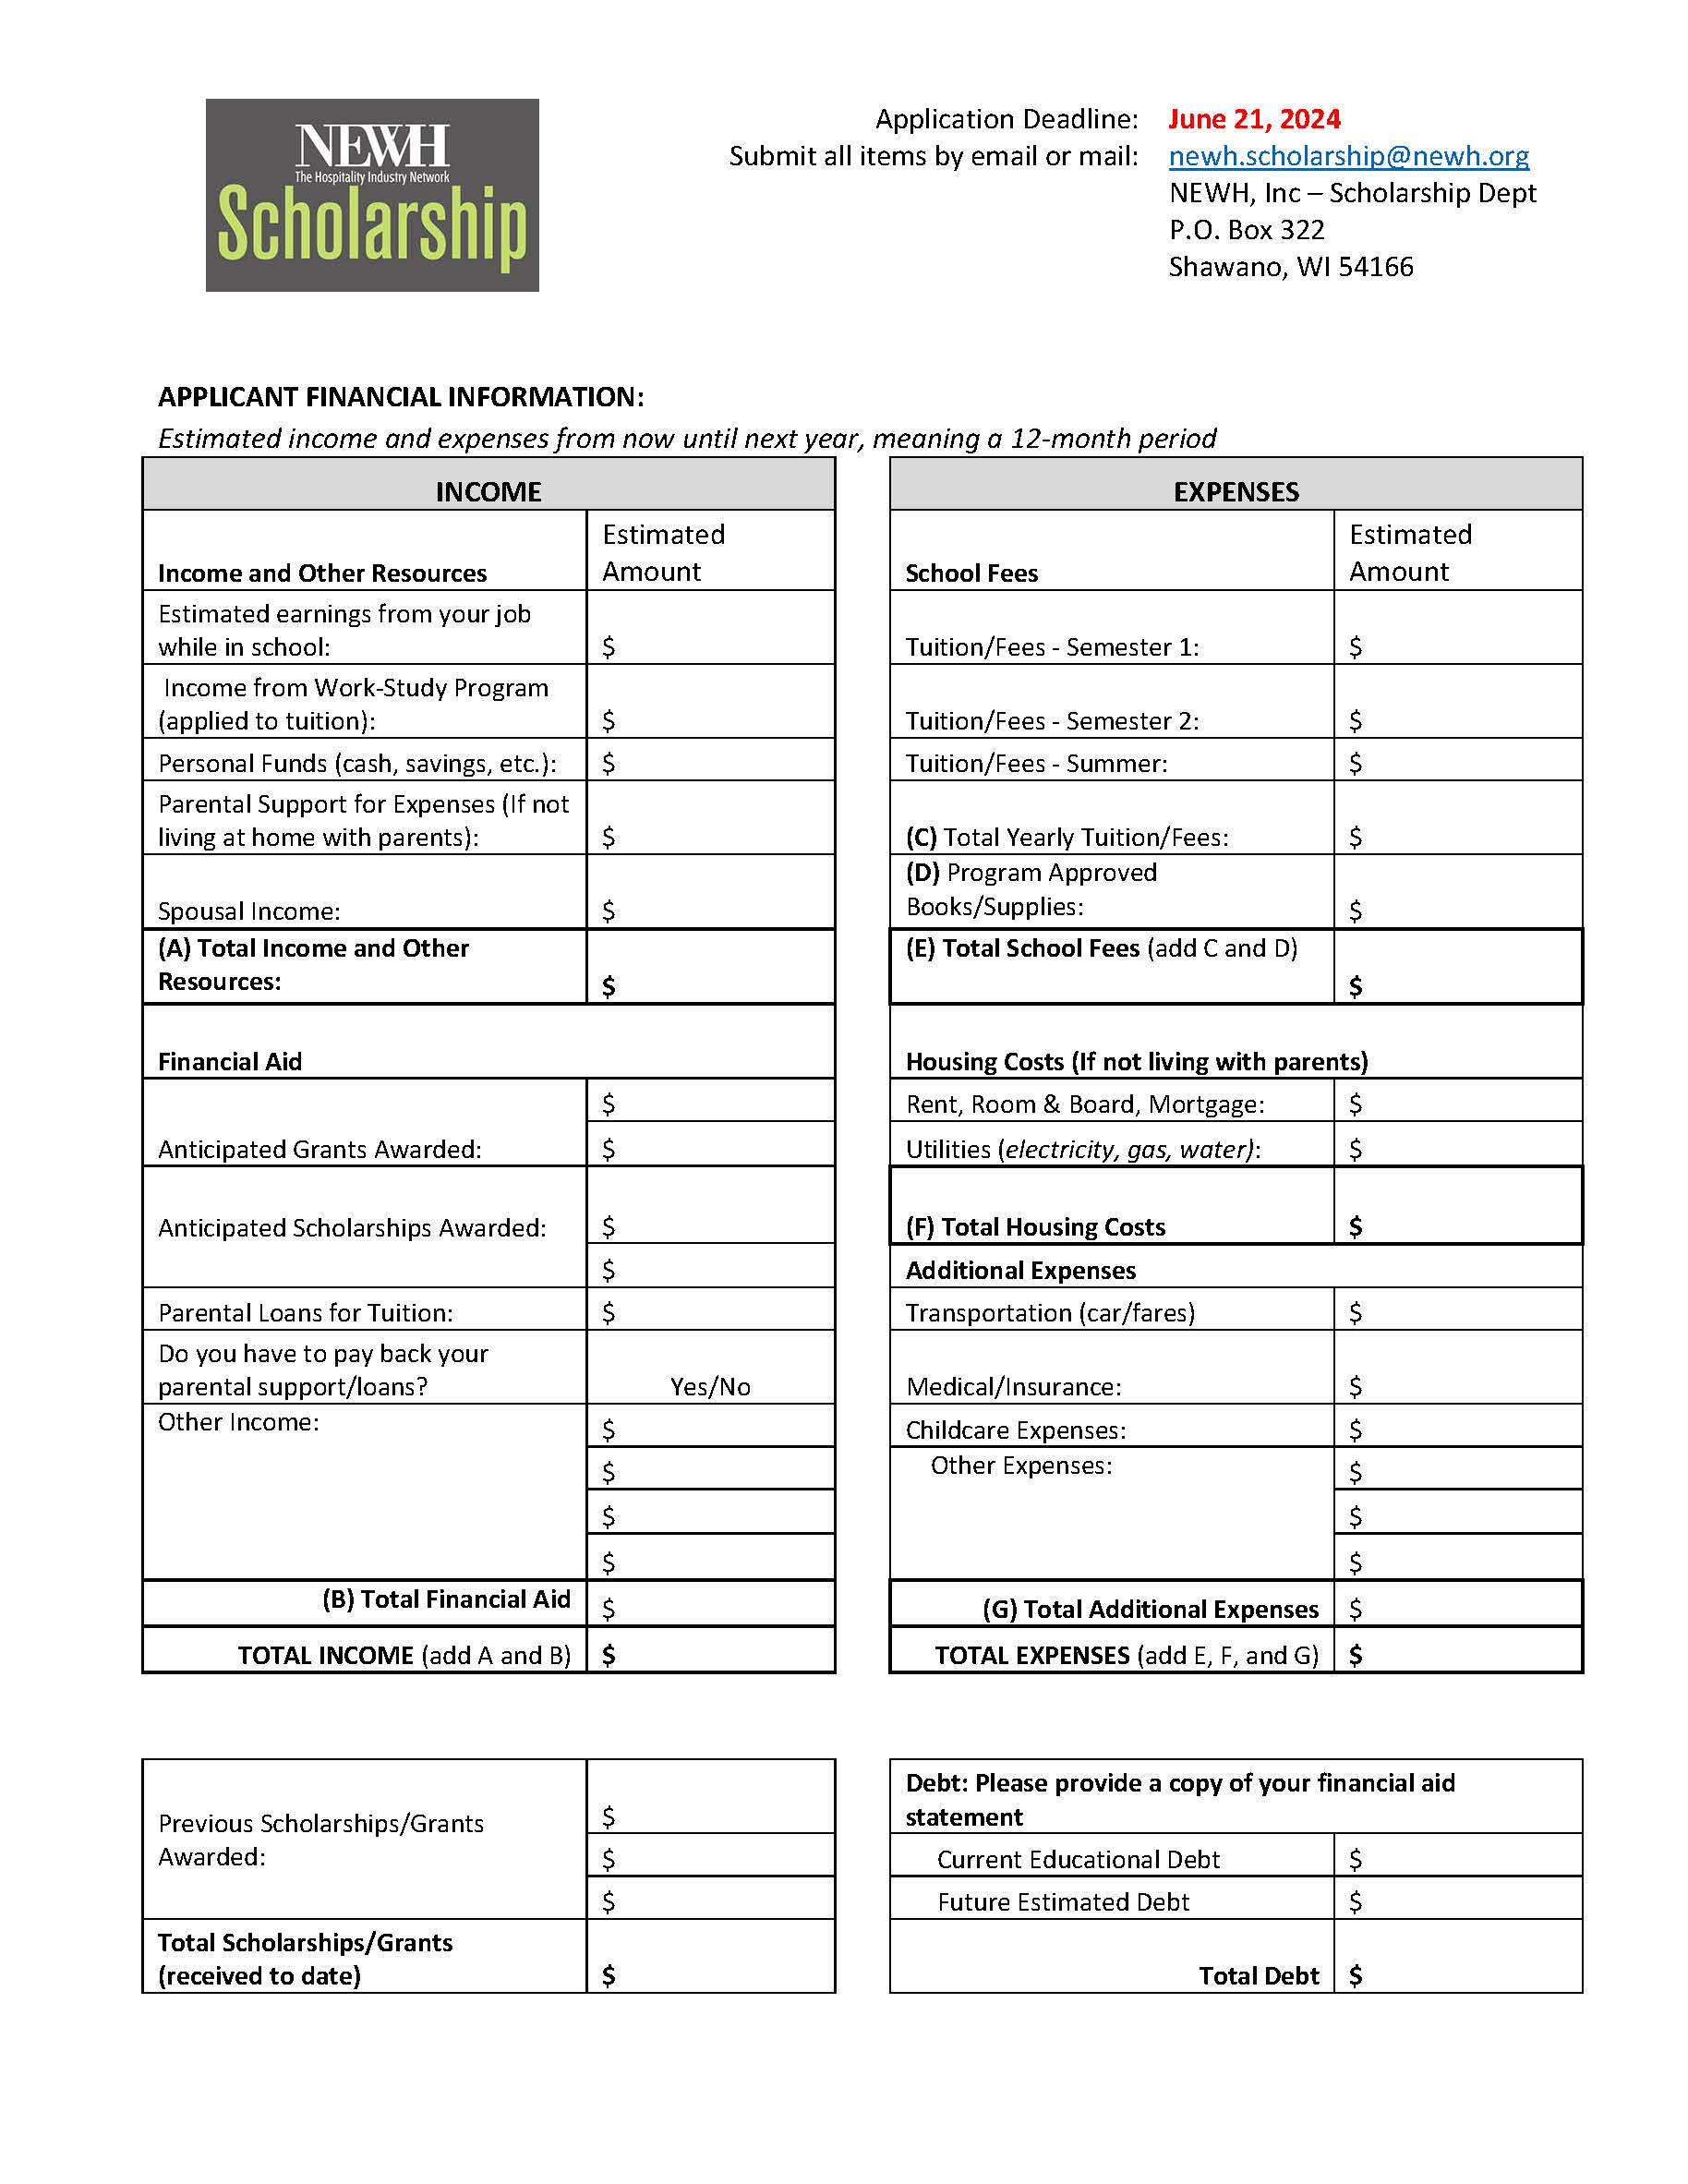
Ask questions of the applicant
(continued)
How to read the application form:
If there is a high amount of parental support, you could ask if the support is a loan, or a gift. Parental loans are still a debt.
Remember that the scholarship funds can only apply towards tuition and books.
If this section is not clear, ask the student to clarify.

Slide 11
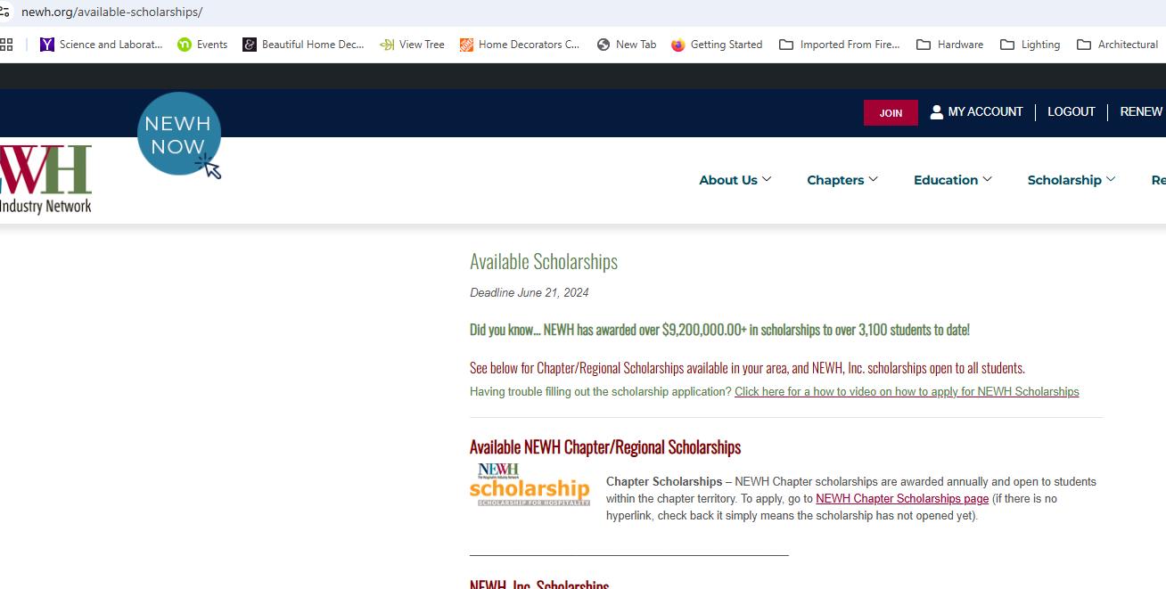

Helping students fill out the forms
https://vimeo.com/1017981661?share=copy

Slide 12
Application scoring system
GPA- 3.0 or Higher – No Points
    No additional points will be awarded based on GPA.
Financial Need- 1-10 Points based on level of need.
  We would suggest giving higher points up to 10 to those applicants who have a greater amount of financial need than others.
    This is a disqualifying factor if need isn’t met.
Official Transcript – 1-5 Points
  Review transcripts for appliable coursework in hospitality and rate based on hospitality related classes taken and/or enrolled in next semester.
Reference/Industry Letters – 1-5 Points (Up to 3 references maximum)
  Required is up to three; not must have three.
    Determine if the reference knows the student well and gave a custom and thoughtful response or if it is a generic cover letter.

Slide 13
Application scoring system
(continued)
Essay- 1-6 points
  Review essay based on requirements of questions asked. There will be another section rating how hospitality related their field of study is. The essay is maximum 500 words with a degree of lenience.
  Answered direct questions on application (6 questions, 1 point per question answered):
(1 point) Background of yourself and your experience.
(1 point) Your goals and objectives after graduation?
(1 point) What prompted you to choose this career?
(1 point) Contributions you have made to your school program or to fellow students through leadership/participation.
(1 point) Why is obtaining this scholarship important to you?
(1 point) If your application is not accepted, what plans do you have for financing?
Hospitality Driven Majors – 1-10 Points based on full review of application.
  Based on the full application (essay, transcripts, future career goal, etc.):
  How hospitality driven is the applicant?
  Does the applicant show interest in hospitality?
  Is the major aligned with NEWH guidelines for the scholarship?
  Does the applicant’s future goals align with the NEWH Mission? Overall impact of application.

Slide 14
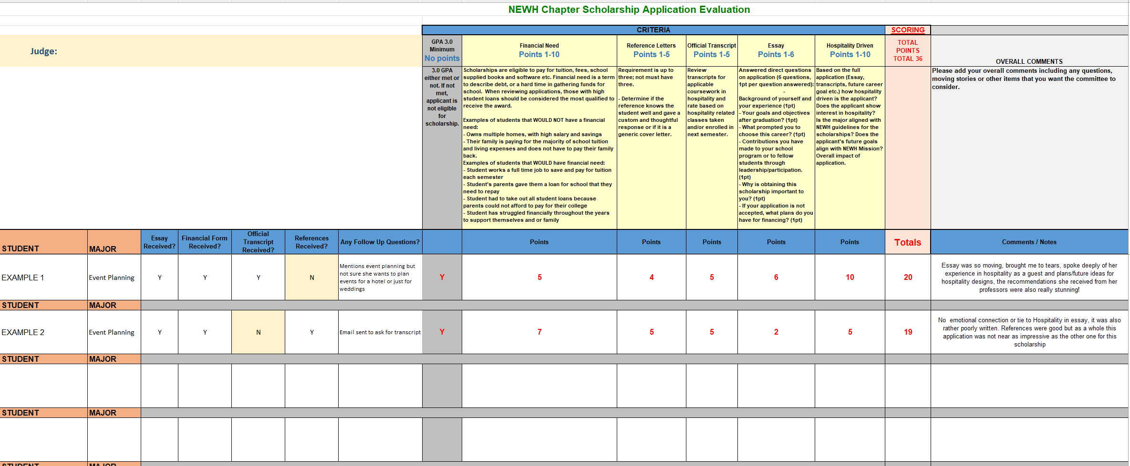
Application scoring system
(continued)
Example of form to determine scoring for each application:

Slide 15
Scholarship examples
Let’s look at a few examples of scholarship applications to apply some of the advice we just gave.

Slide 16
What to look out for with AI/Chat GPT
Purpose of AI Use
AI (Artificial Intelligence) may be used for brainstorming, idea generation, or grammar enhancement. It should not be used to write or heavily edit the entire essay.
1. Originality Requirement
The content of the essay must be the applicant’s own ideas, voice, and expression.AI-generated content should not be the primary contributor.
2. Transparency
If AI tools are used, applicants must disclose this in the submission process (e.g., “AI was used for grammar checking and idea organization”).
3. Critical Thinking
Essays should demonstrate the applicant’s own critical thinking, problem-solving, and personal reflections. AI should not replace or imitate these aspects.
4. Academic Integrity
Any form of plagiarism, including using AI to paraphrase or generate content based on others’ work, is prohibited.
5. Quality Control
The final essay must reflect the student’s own voice and intellectual input. AI assistance should enhance clarity, not alter the core message or ideas.
6. Fake Letters of Recommendation
Any fake or AI-generated letters of recommendation that impersonate professors, mentors, or other individuals will result in immediate disqualification from the competition. All letters must be authentic and written by the actual recommender.
7. Essay Content Criteria
The Use of AI tools may affect the essay’s originality, authenticity, and depth of thought.
8. Accountability
Applicants are fully responsible for the content submitted.

Slide 17
AI examples
Let’s look at a few examples of where AI was most noticeable and how it could impact your scoring

Slide 18
Determining the Winner
Each committee member will receive a certain number of applications to review. Once they have gone through the scoring sheet, they will narrow it down to their top 2-3 applications
In a separate committee meeting, all reviewers will bring their top applicants and sell their application to the committee as to why they feel these students should be considered to receive the award
Committee members will present their top candidates and then it will go into three piles:
  Yes – moves on final review
  Maybe gets another look if we do not have enough yes’s and we re-read the essay
  No – gets disregarded and does not get presented
In person, or video interviews may be conducted if the committee is having a hard time narrowing it down, or they want to hear more about the stories that the applicants have told in their essays. Of course, there should be no discrimination of race, religion, or need during these interviews
The top applicant(s) get presented to the Chapter President and the Chapter decides on who will be the final winner and what scholarship amounts that they will be receiving.
Most Important: BEFORE announcing to the student that they have won a scholarship, it is required that you send the applicants information to Erika.Swansen@NEWH.org first so that the team can do a final vetting to ensure the applicant meets the qualifications.

Slide 19

Love a student but they don’t qualify?
If there are stellar applicants but the Chapter/Region does not have the funds to award all of them or they do not have any financial need, consider creating an honorary award, or a special mention of them during the awards ceremony
This award would not provide the student with any monetary funds but it would be a way to help celebrate them and give them a resume booster.

Slide 20
Keeping Students Engaged
We invest a lot into our student scholarship recipients. We invest in their story, their success, and we want them to be a part of our organization after they graduate as well so that we can watch them grow. Many times, these scholarship recipients end up joining the NEWH Chapter Board and becoming Scholarship Directors themselves. It is heartwarming to see them continue the cycle of giving to these students. We aim for the Chapters to engage in the students and check-in with them afterwards to help them on their path and encourage them to stay involved in our organization.
Keep in touch with as many students as we can.
Have at least one student liaison who was a scholarship winner each year on the board.
Invite students and recent graduates to NEWH networking events.
Reach out to student members to see if they’d like to help with outreach at their schools to promote to applications.
Remind them that student memberships are free and they get a free year of an associate membership once they graduate.
Invite them to like the local Chapter’s social media pages to stay informed of events and happenings.
Ask your winners to tell their NEWH story through video, interviews, or photos.
Submit photos/video of scholarship awards or interview with students to NEWH Inc.
Invite them to join the emerging talent board on www.newh.org.
They can look for jobs on the NEWH Career Network.

Slide 21
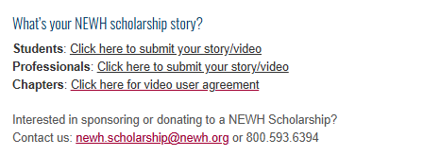
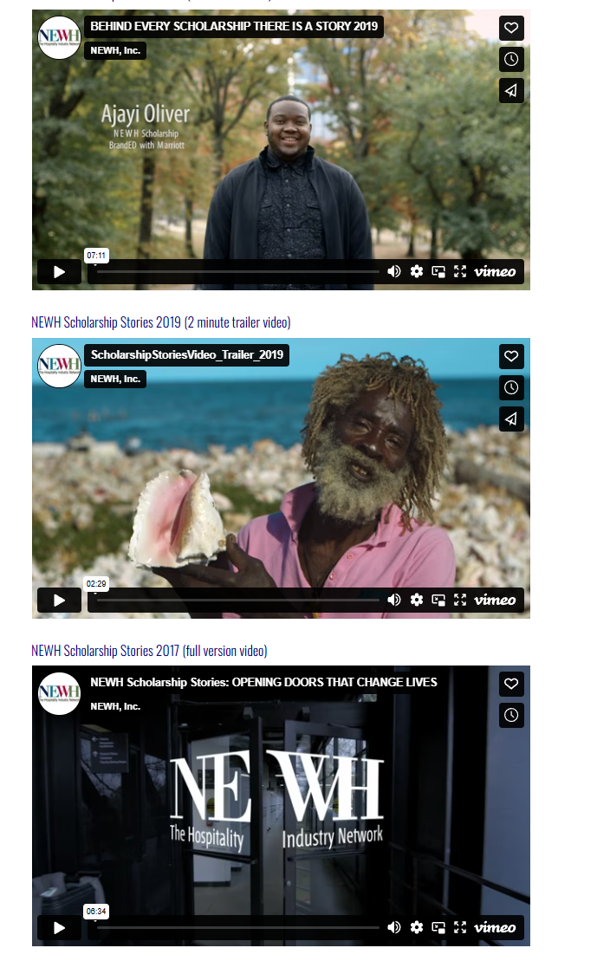
Telling our scholarship stories
Keep track of your winners and encourage them to share their NEWH Scholarship Story!

Slide 22

Thank you for serving!
We thank you for all of your hard work to provide scholarships to well-deserved students.

