Slide 4
At Durkan, a division of Mohawk Group, we are committed to the health and wellness of our employees, customers and the communities in which we live, work and play. We continuously challenge ourselves to design and manufacture products with reduced
environmental and social impacts.
We also believe this commitment goes beyond a project’s initial installation and we strive to provide our valued customers and end users with important information to maintain safe and healthy environments.

Slide 5
Better Knowledge

Slide 6
How to Clean Carpet and
Hard Surface Flooring

Slide 7
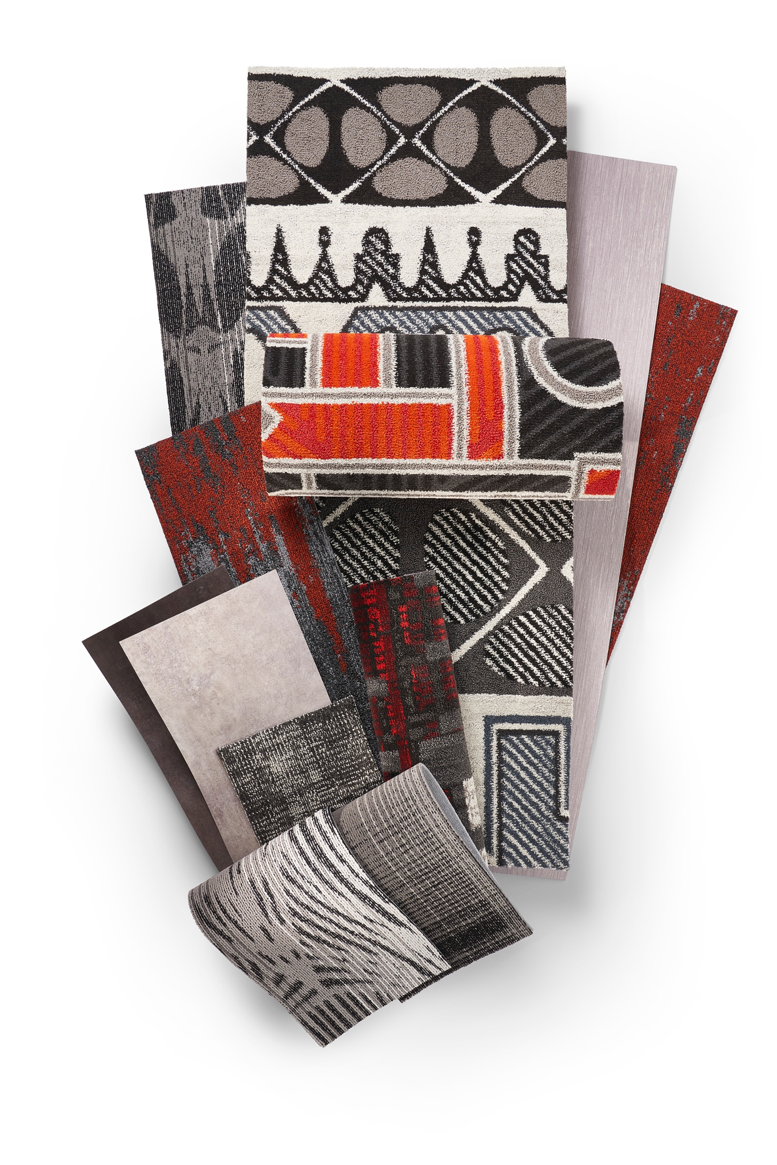
In the wake of current events, there is heightened concern regarding the proper methods to appropriately clean and disinfect hard surface flooring and carpeting in commercial applications.
Did you know that if you have already implemented a regular cleaning schedule and regimen you are already decreasing any risk of spreading infections?

Slide 8
“Cleaning refers to the removal of dirt and impurities, including germs, from surfaces. Cleaning alone does not kill germs. But by removing the germs, it decreases their number and therefore any risk of spreading infection.”
CDC.gov/coronavirus/2019-ncov/community/organizations/cleaning-disinfection.html

Slide 9
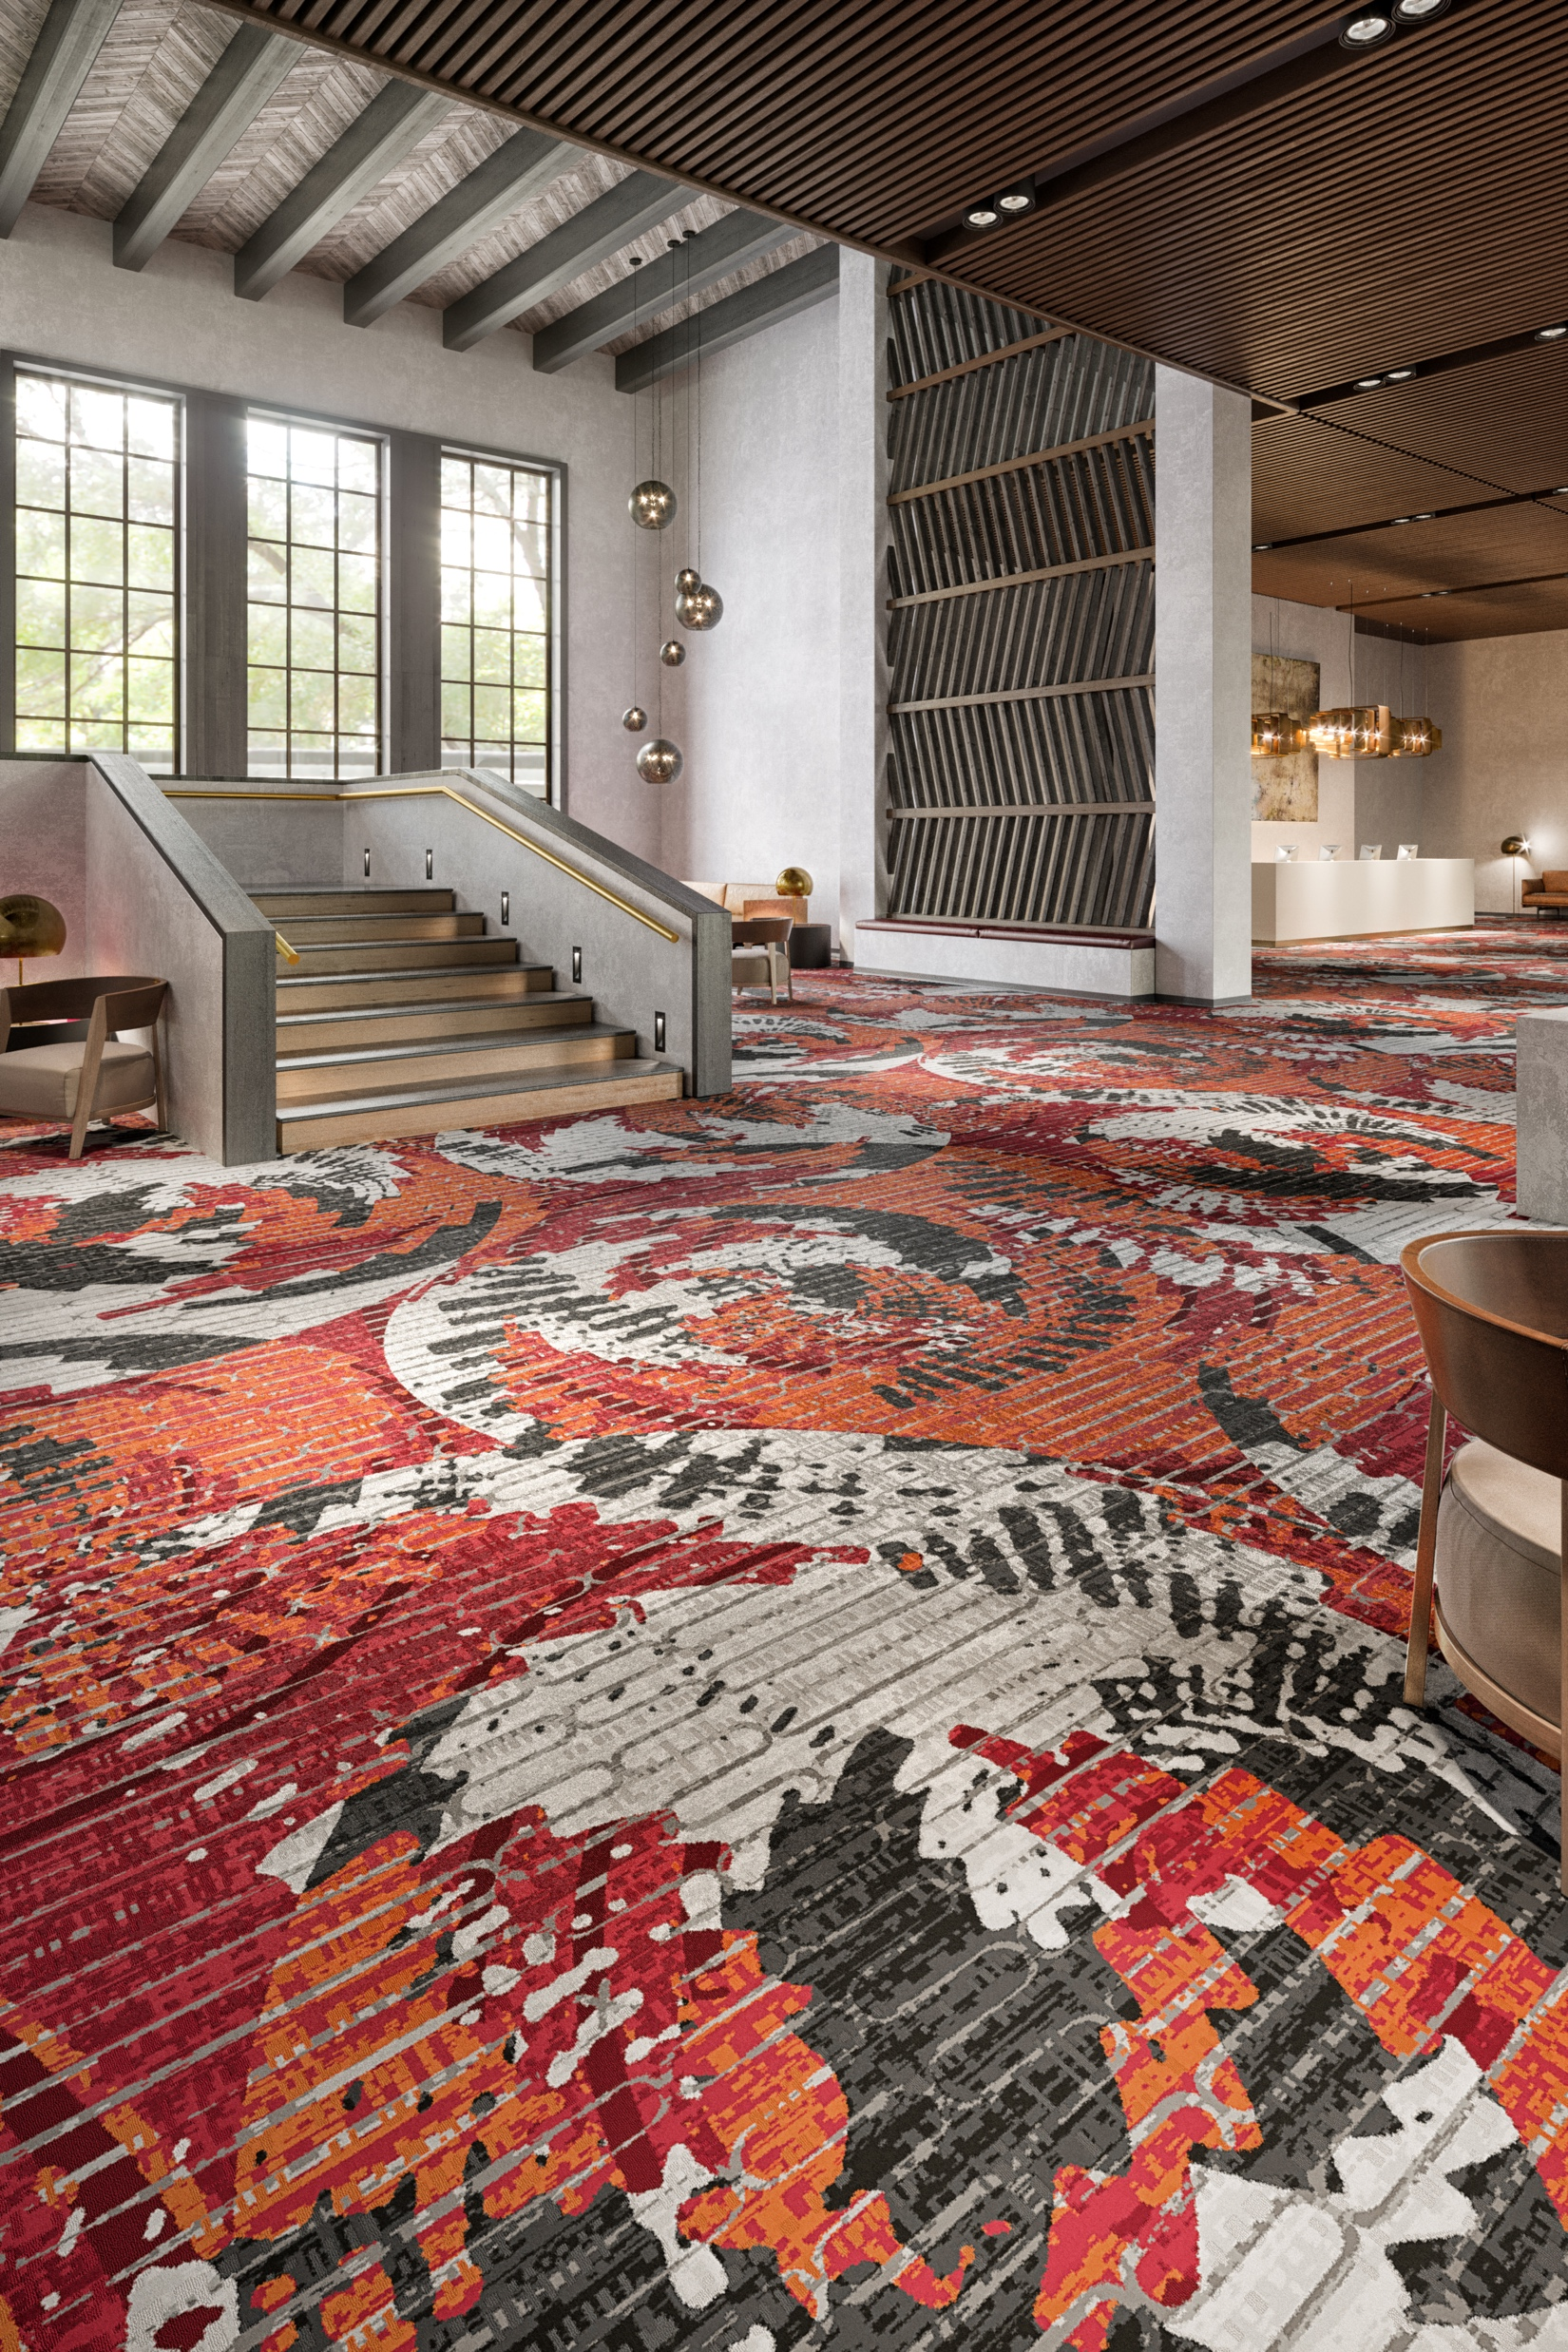
The first step to effectively maintaining a safe and healthy environment is a regular cleaning
schedule and regimen.
Preventative Maintenance – Entry Systems
Regular Vacuuming (Soft) / Dust Mop (Resilient)
Daily Spill & Spot Cleaning
Deep Cleaning* – Hot Water Extraction (Soft) / Machine Scrub (Resilient)
The most important step in decreasing the risk of spreading infection is just doing the basics such as regular vacuuming of carpet and keeping hard surfaces clean.
*As Required

Slide 10
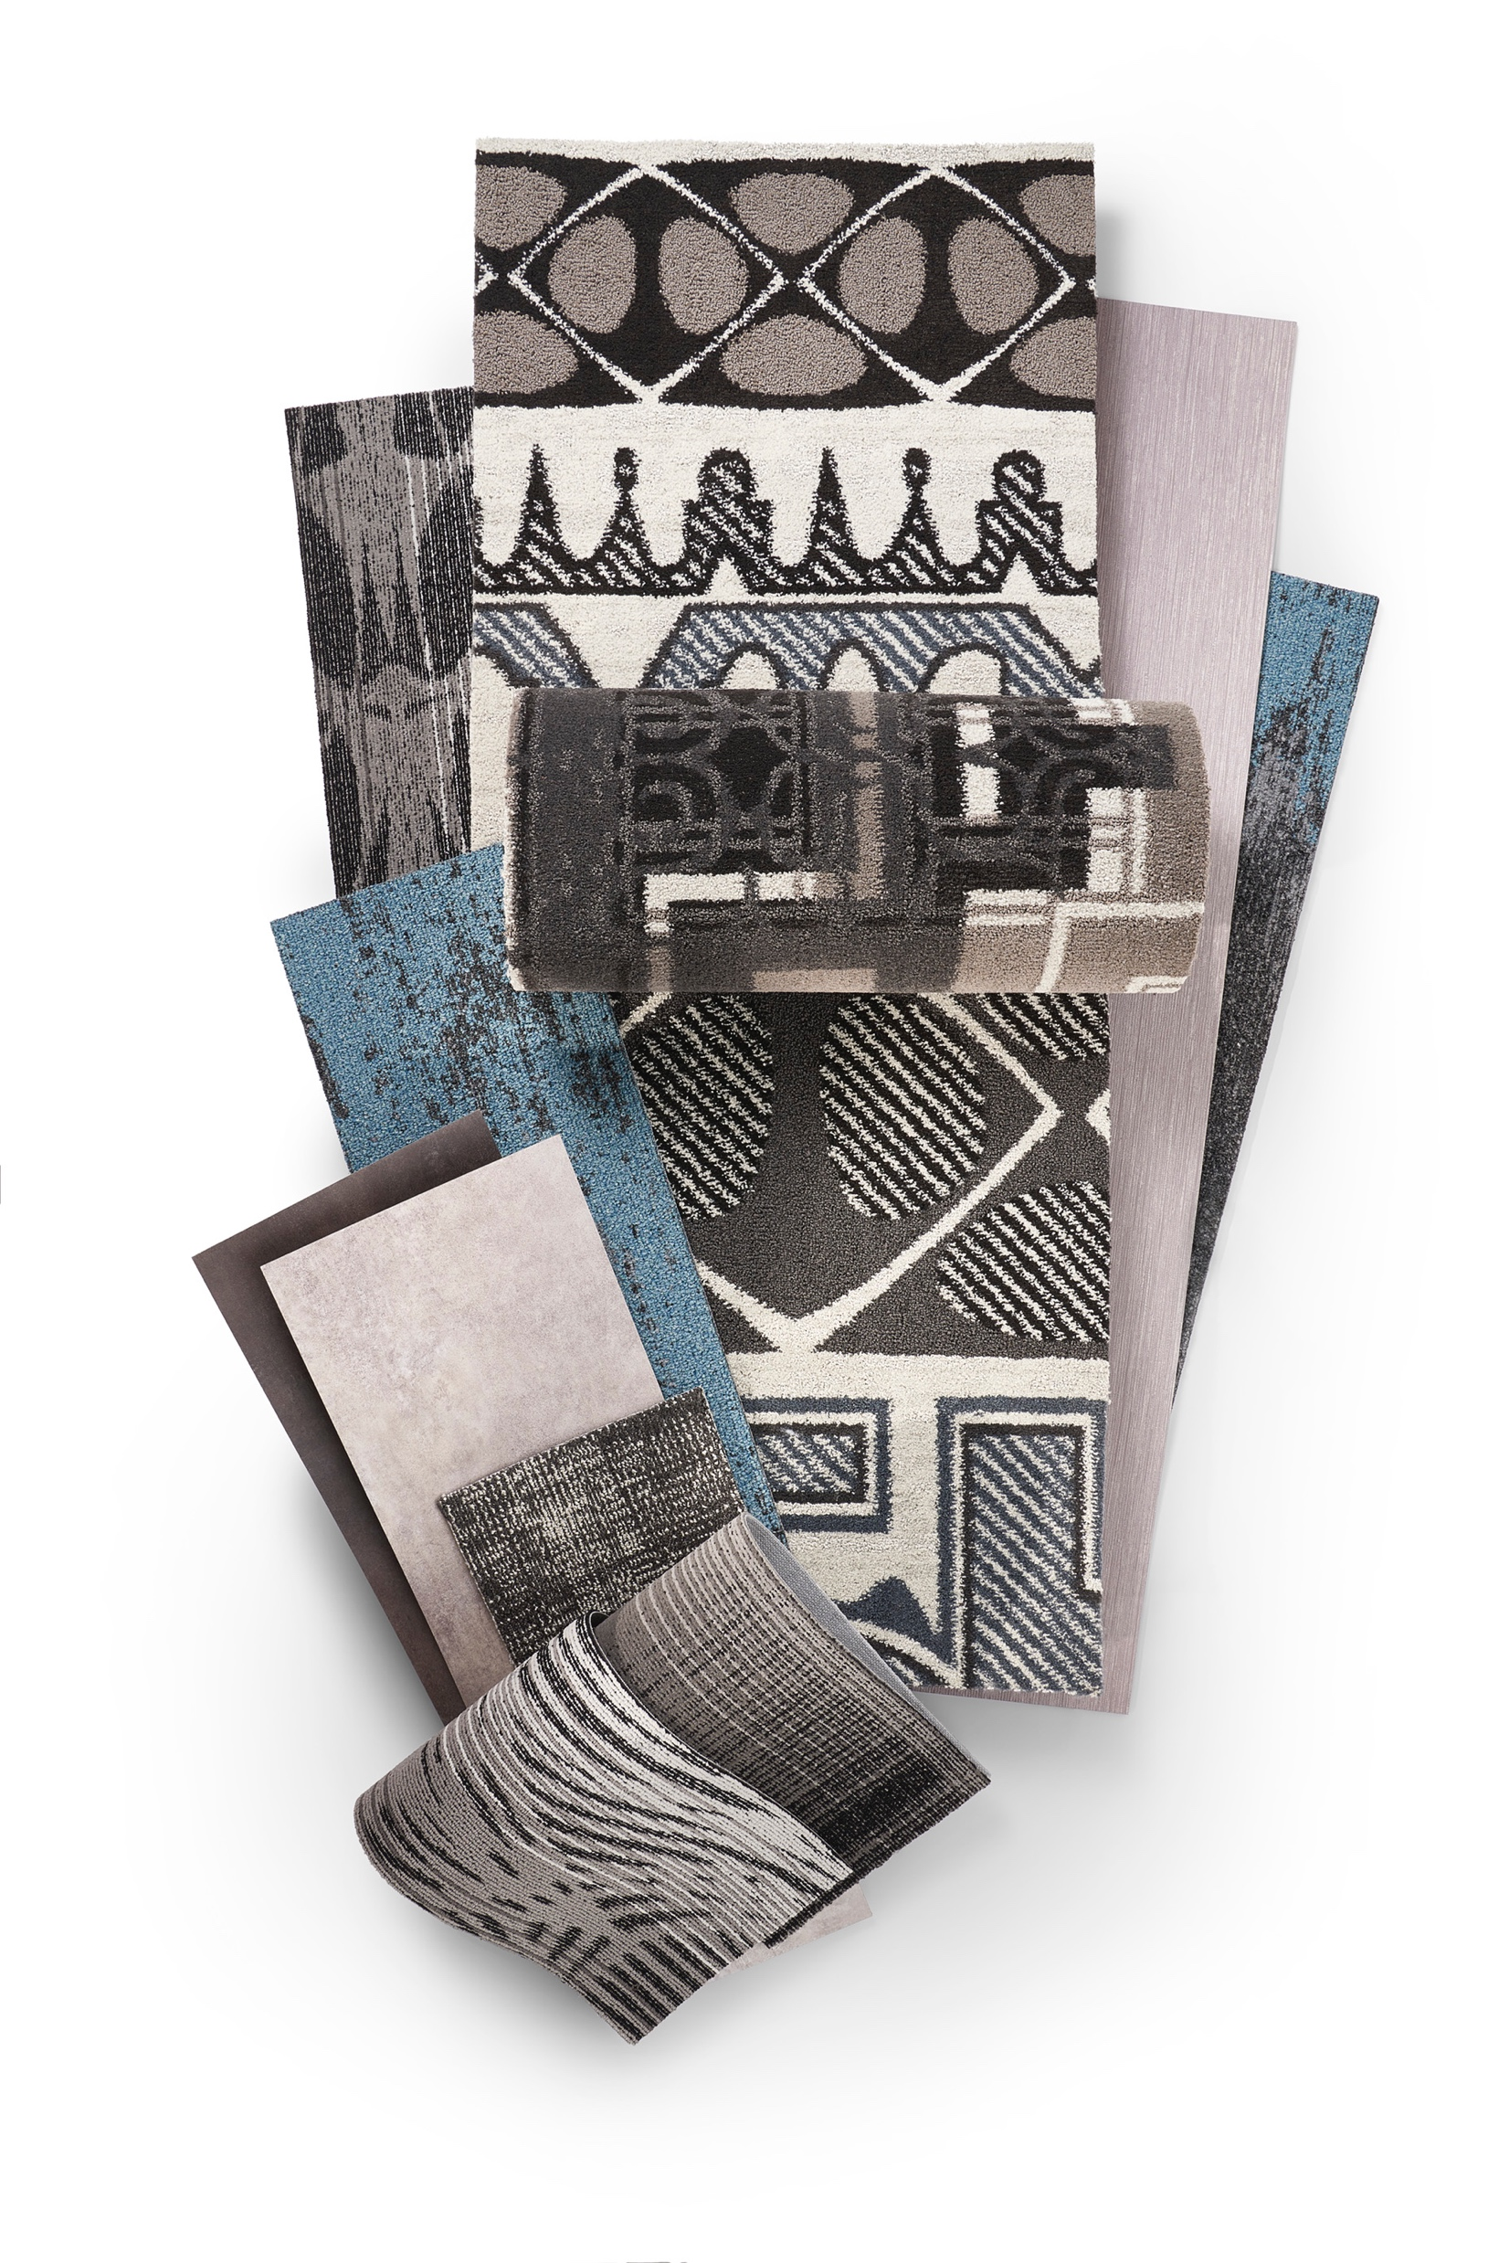
Mohawk Group’s instructions for regular care and maintenance of soft and resilient flooring
can be found here:
MohawkGroup.com/carpet/more/performance-and-technical?tab=tab6

Slide 11
It’s also important to understand how COVID-19 is spread. According to the CDC guidelines “transmission occurs via respiratory droplets” and “Transmission of SARS-CoV-2 to persons from surfaces contaminated with the virus has not been documented.”
The CDC adds, “Transmission of coronavirus in general occurs much more commonly through respiratory droplets than through fomites [objects or materials which are likely to carry infection, such as clothes, utensils, and furniture]. Standard flooring maintenance should be sufficient.

Slide 12
Which Cleaners/Chemicals Are Safe to Use?

Slide 13
If you need to clean and disinfect your space, follow the CDC guidelines with a thorough cleaning followed by a proper disinfectant treatment.
The cleaning chemical you already use on your flooring may meet CDC requirements. To confirm that is true, the CDC guidelines also contain links to lists of disinfectants that have been approved by the Environmental Protection Agency (EPA) for use in mitigating the spread of viruses such as COVID-19.
They regularly update the list, so we suggest checking there first.

Slide 14
To confirm a disinfectant has been approved by the EPA for use in mitigating the spread of viruses such as COVID-19, please visit:
EPA.gov/sites/production/files/2020-03/documents/sars-cov-2-list_03-03-2020.pdf

Slide 15
Before using any of these cleaning solutions, consult the manufacturer’s instructions and always remember to test disinfectants in an inconspicuous area.
If you have any further questions, please do not hesitate to contact your local account executive or Mohawk Technical Services at
800-833-6954. We are here to assist you.

Slide 16
Are Antimicrobials Important for
Fiber and Backings?

Slide 17
Antimicrobial treatments in fiber and backing are an interesting topic, especially during a time of heightened awareness, and may sound like an effective solution to mitigate the risk of spread of infectious disease, in addition bacterial or mold-related odors. But amidst all the noise and claims in the marketplace we again recommend relying on the experts.

Slide 18
From a technical document by the Carpet and Rug Institute:
“All antimicrobial treatments are regulated by the United States Environmental Protection Agency (EPA). For EPA registration, these antimicrobial preservatives must undergo extensive toxicological assessments. The EPA Treated Articles Exemption (EPA PR Notice 2000-1) states that articles treated with an EPA-registered product may make claims only related to protection of the treated article against bacterial- or mold-related odors and staining. No implicit human health claims may be made unless the finished treated article (itself) is EPA registered. This EPA regulatory clarification is key in curbing over-zealous marketing claims regarding the intended function of the antimicrobial treatment. Currently, there are no carpets registered as finished treated articles, therefore no healthcare claims can be made or implied for carpets with these treatments.”

Slide 19
Hospitality vs. Healthcare
Should You Use Different Flooring Products?

Slide 20
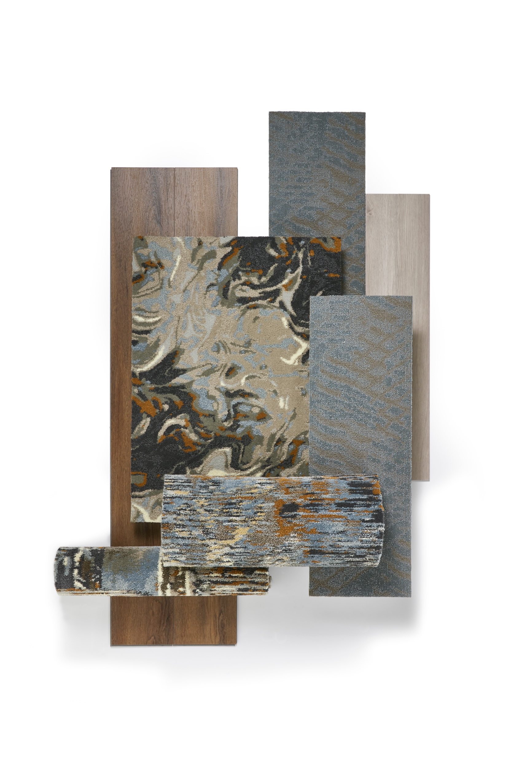
The most important learning from healthcare is not the products they choose, but the fact-based study that goes into their decisions. In times of uncertainty, where we are seeking answers, we should follow the example of healthcare and seek informed guidance from independent experts.

Slide 21
If you have any further questions, please do not hesitate to contact your local account executive or Mohawk Technical Services at
800-833-6954. We are here to assist you.

